Slide 1


A GPU Algorithm for Detecting Strongly Connected Components
Ghadeer Alabandi^{TXST}, William Sands^{UTA}, George Biros^{UTA}, and Martin Burtscher^{TXST}

Slide 2
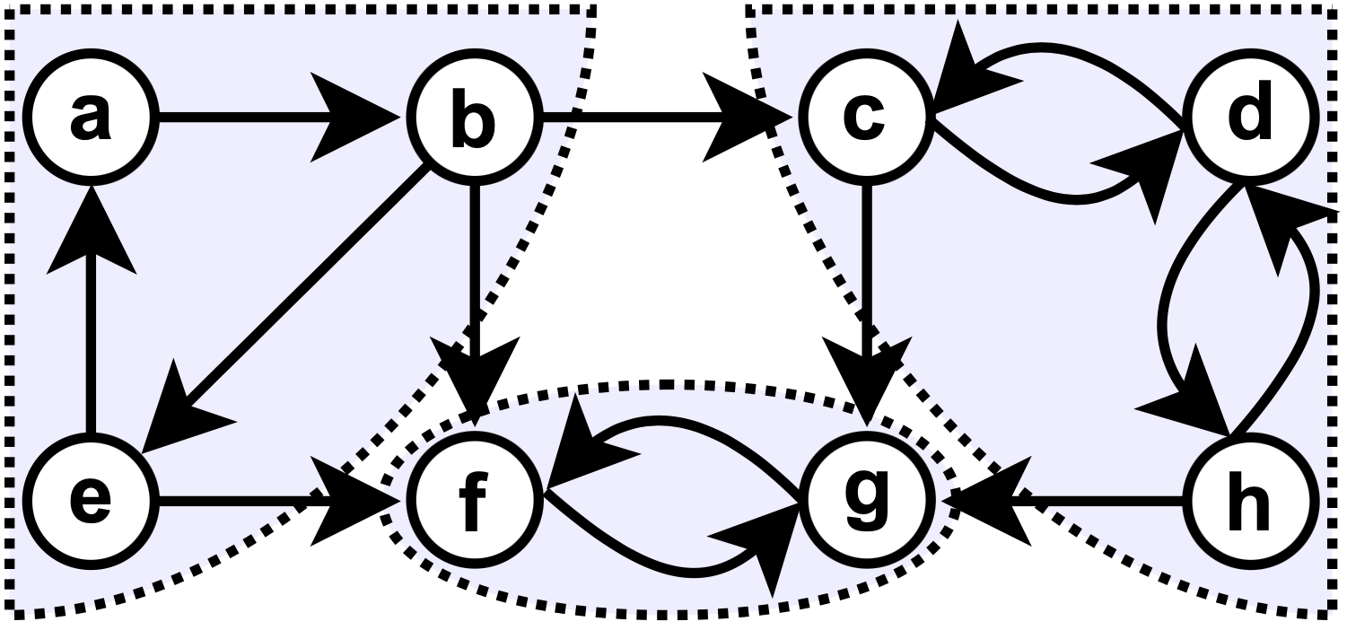
Strongly Connected Components (SCC)
SCC of directed graph 𝐺 = (𝑉, 𝐸)
Maximal subset 𝑆 of vertices that can reach each other
General SCC properties
Every vertex belongs to exactly one SCC
Contracting each SCC into a single vertex turns 𝐺 into a Directed Acyclic Graph (DAG)
Finding SCCs is key building block in many apps
Obtained form wikipedia

Slide 3
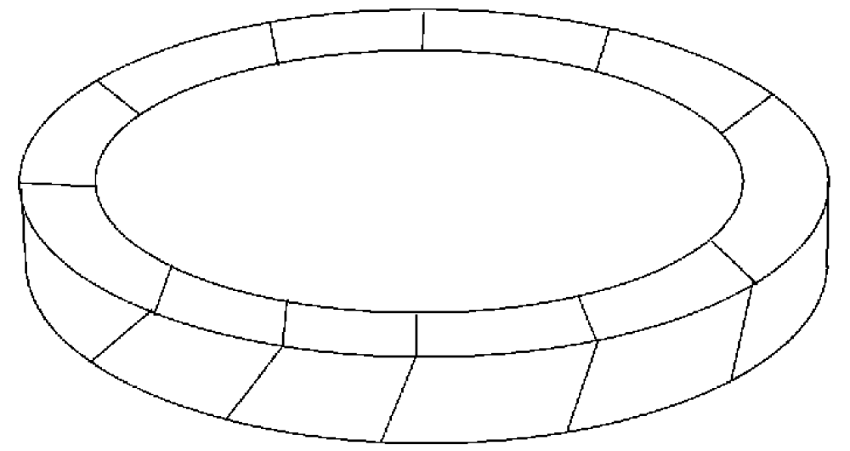
SCC Detection in Sweep-based Solvers
Sweep solvers for thermal radiation transfer
Sweep over domain in multiple directions Ω
Each direction induces a directed graph
Cycles in induced graphs
Can lead to accuracy and livelock issues
SCC identification
Critical first step in some sweeping algorithms
Needs to be performed for each sweep direction
Ω
Plimpton et al. 2005

Slide 4

Highlights of our ECL-SCC Algorithm
Parallelism and GPU friendly
New algorithm based on innovative techniques
Maximum vertex-ID propagation
Edge removal
ECL-SCC running on an A100 GPU
Outperforms fastest GPU code by 6.5× on mesh graphs
Outperforms fastest GPU code on power-law graphs
Outperforms fastest serial and parallel CPU code

Slide 5
Prior Algorithms

Slide 6
Tarjan’s Serial Algorithm
Well-known sequential approach for detecting SCCs
Runs in linear time in the number of edges and vertices of 𝐺
Very fast in practice
Based on depth-first search
Prevents efficient parallelization

Slide 7
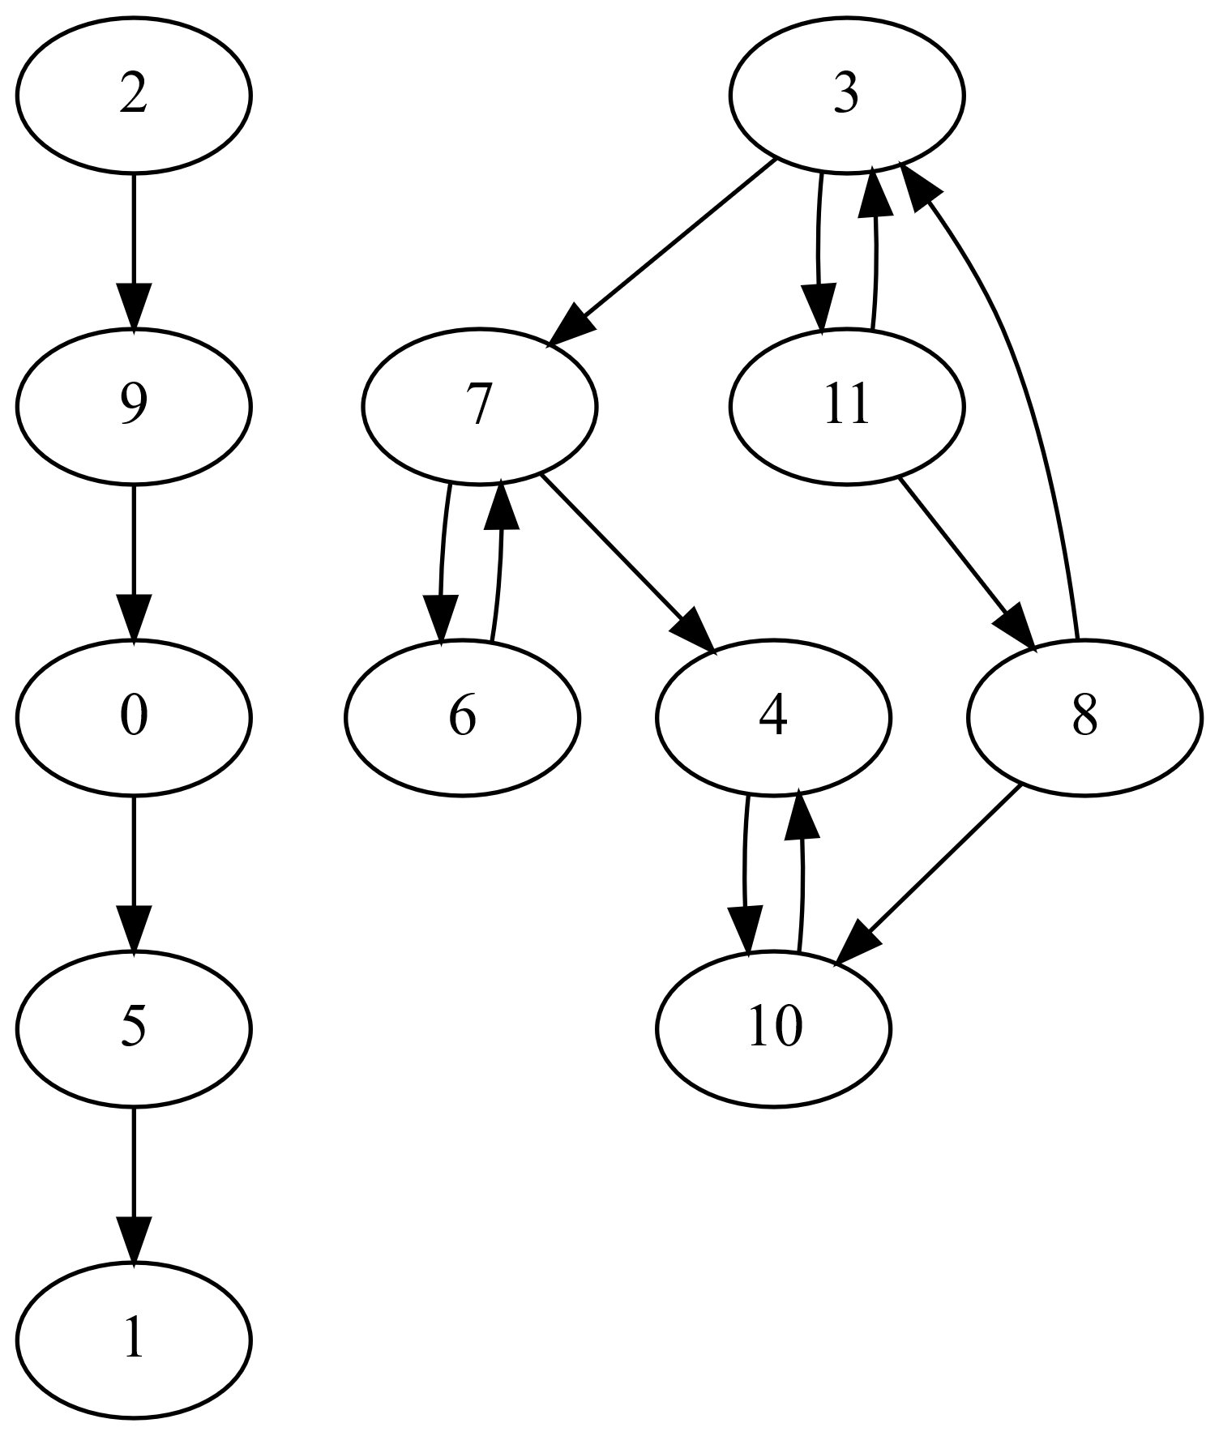
Parallel Forward-Backward Algorithm
Leading parallel SCC algorithms are based on Forward-Backward (FB) approach
Randomly select a pivot vertex
Perform parallel forward BFS
Perform parallel backward BFS
Result partitions graph into 4 subgraphs
Vertices reached by both BFSs (green)
Vertices only reached by fwd BFS (blue)
Vertices only reached by bwd BFS (yellow)
Vertices not reached by BFS (unshaded)
First set (green) is done (SCC of pivot)
Recurse on latter three sets
Independent, can be done in parallel

Slide 8
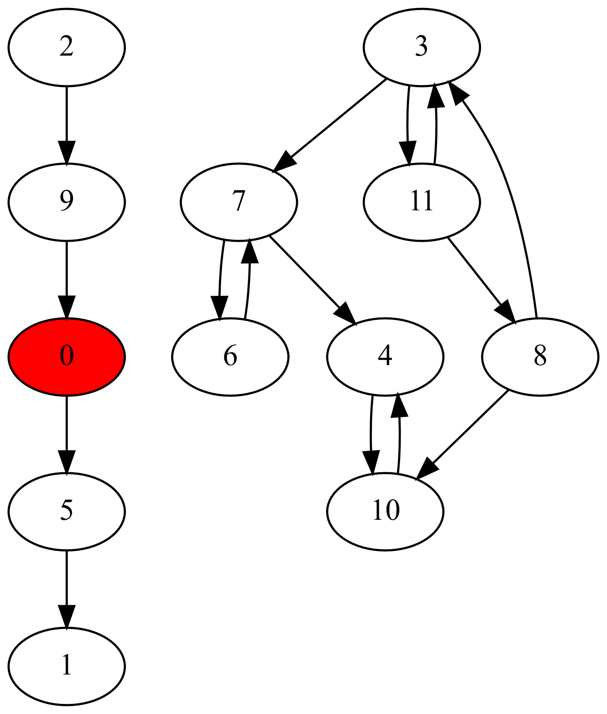
Parallel Forward-Backward Algorithm
Leading parallel SCC algorithms are based on Forward-Backward (FB) approach
Randomly select a pivot vertex
Perform parallel forward BFS
Perform parallel backward BFS
Result partitions graph into 4 subgraphs
Vertices reached by both BFSs (green)
Vertices only reached by fwd BFS (blue)
Vertices only reached by bwd BFS (yellow)
Vertices not reached by BFS (unshaded)
First set (green) is done (SCC of pivot)
Recurse on latter three sets
Independent, can be done in parallel

Slide 9
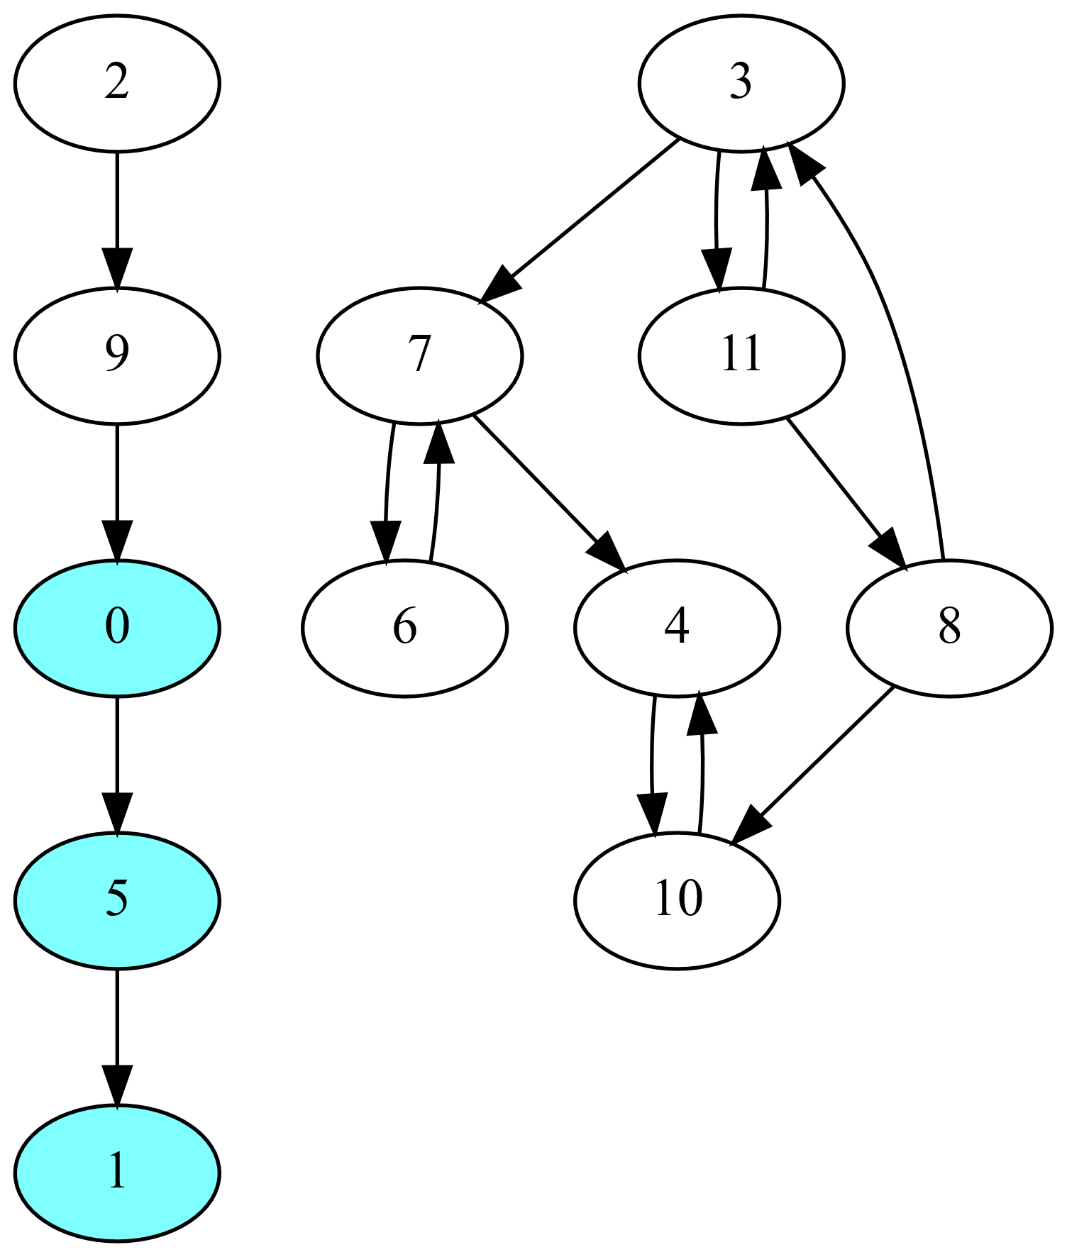
Parallel Forward-Backward Algorithm
Leading parallel SCC algorithms are based on Forward-Backward (FB) approach
Randomly select a pivot vertex
Perform parallel forward BFS
Perform parallel backward BFS
Result partitions graph into 4 subgraphs
Vertices reached by both BFSs (green)
Vertices only reached by fwd BFS (blue)
Vertices only reached by bwd BFS (yellow)
Vertices not reached by BFS (unshaded)
First set (green) is done (SCC of pivot)
Recurse on latter three sets
Independent, can be done in parallel

Slide 10
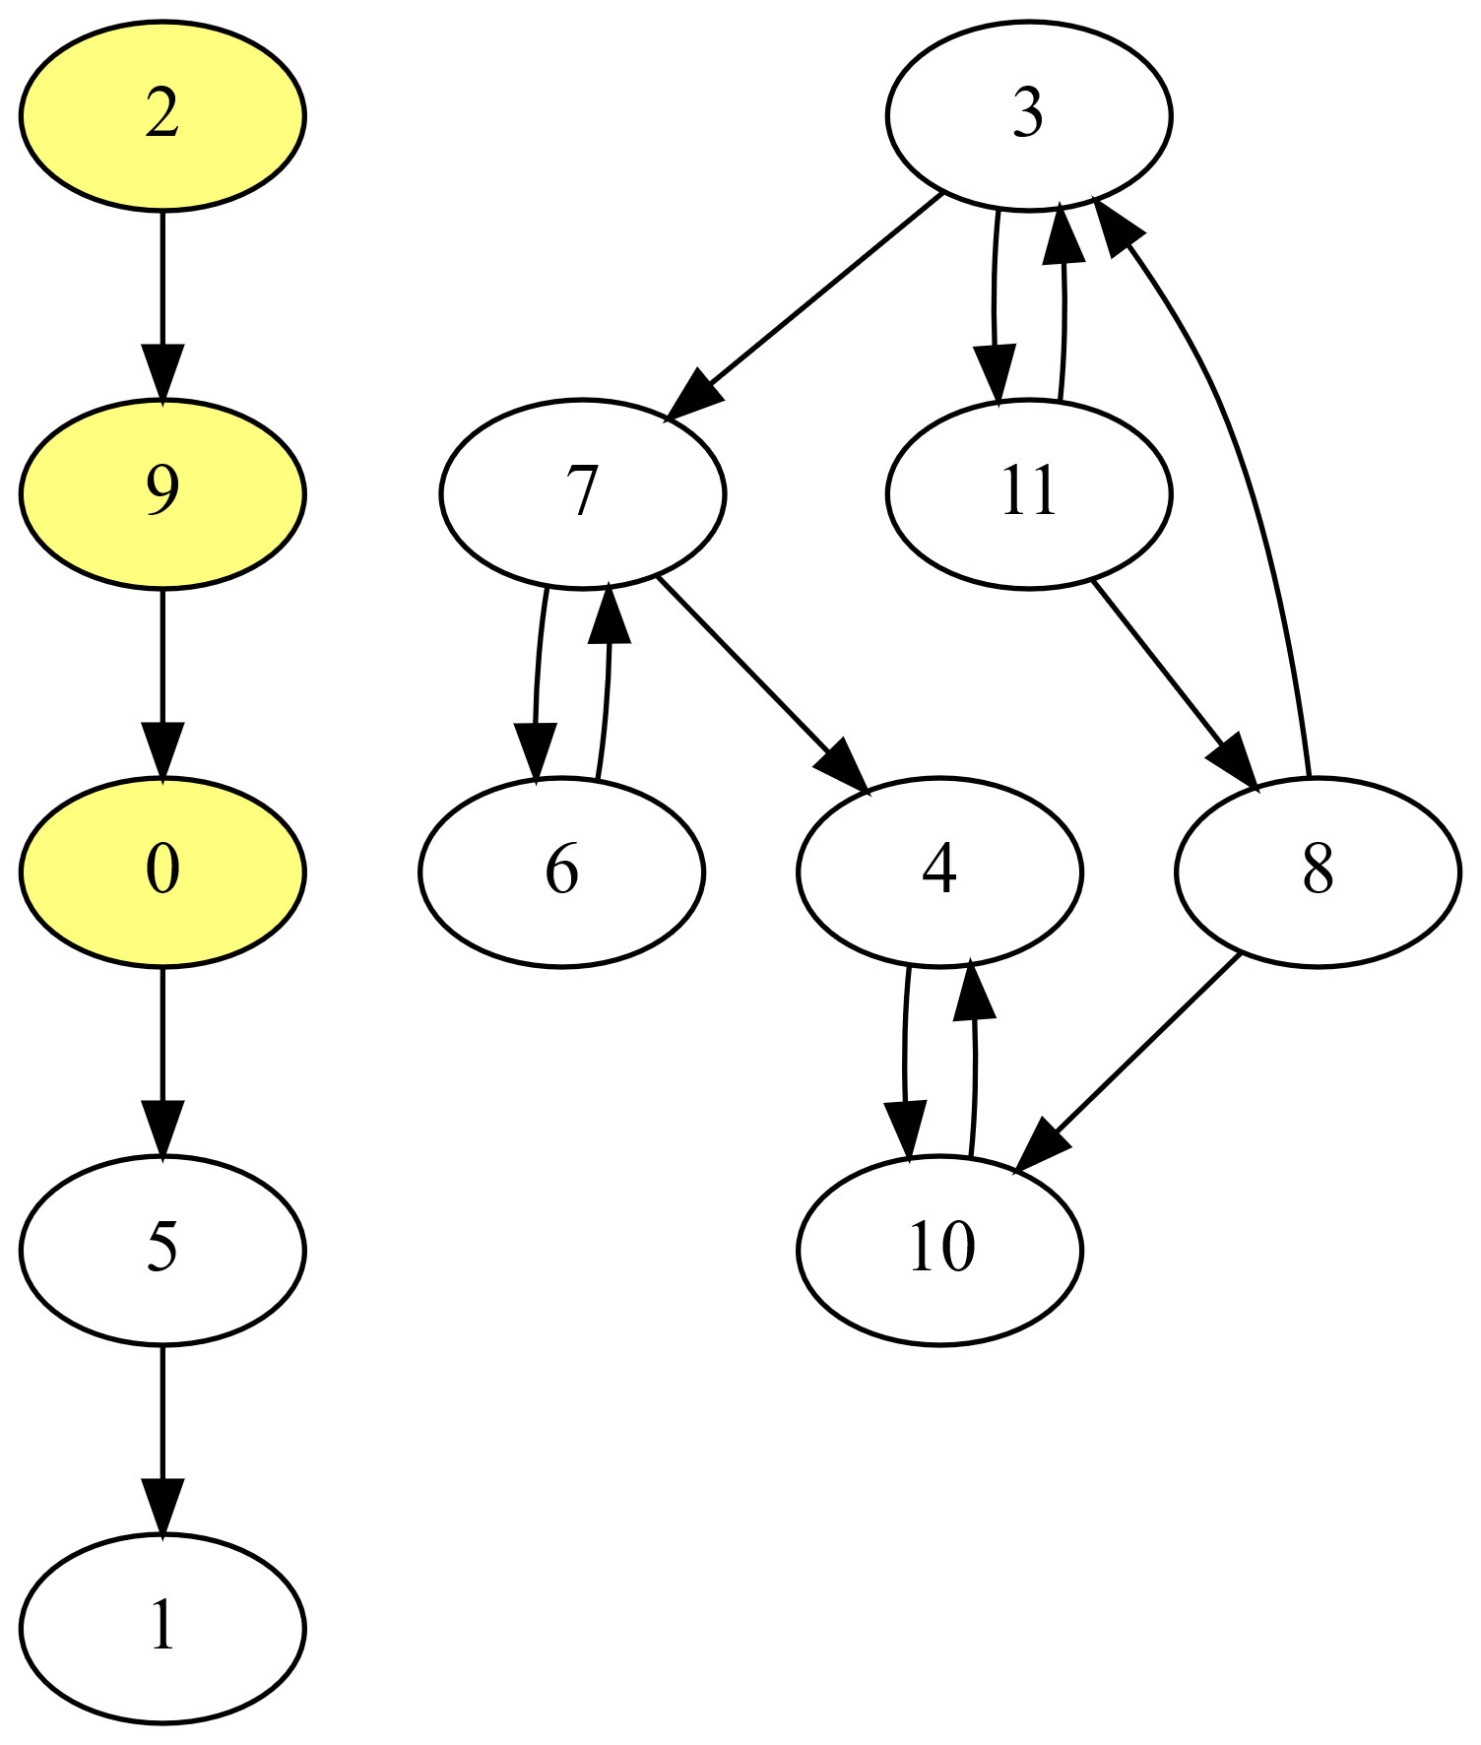
Parallel Forward-Backward Algorithm
Leading parallel SCC algorithms are based on Forward-Backward (FB) approach
Randomly select a pivot vertex
Perform parallel forward BFS
Perform parallel backward BFS
Result partitions graph into 4 subgraphs
Vertices reached by both BFSs (green)
Vertices only reached by fwd BFS (blue)
Vertices only reached by bwd BFS (yellow)
Vertices not reached by BFS (unshaded)
First set (green) is done (SCC of pivot)
Recurse on latter three sets
Independent, can be done in parallel

Slide 11
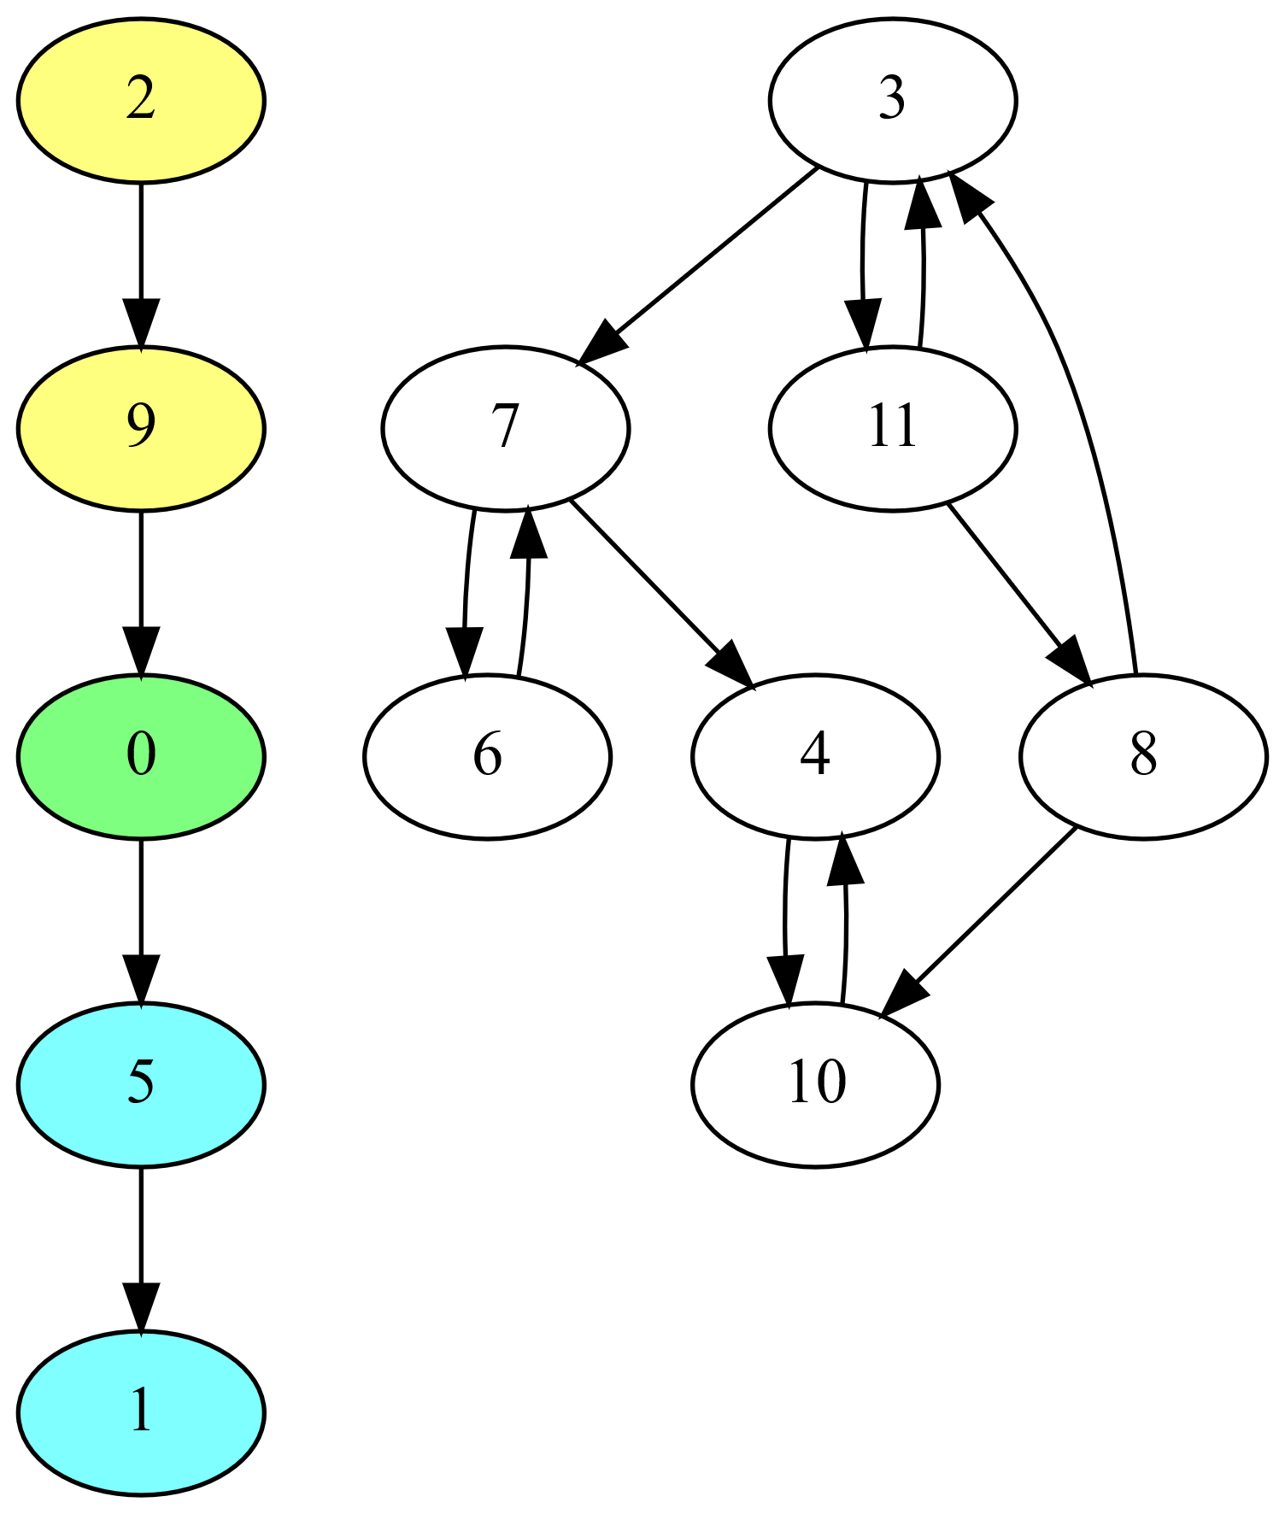
Parallel Forward-Backward Algorithm
Leading parallel SCC algorithms are based on Forward-Backward (FB) approach
Randomly select a pivot vertex
Perform parallel forward BFS
Perform parallel backward BFS
Result partitions graph into 4 subgraphs
Vertices reached by both BFSs (green)
Vertices only reached by fwd BFS (blue)
Vertices only reached by bwd BFS (yellow)
Vertices not reached by BFS (unshaded)
First set (green) is done (SCC of pivot)
Recurse on latter three sets
Independent, can be done in parallel

Slide 12
Parallel Forward-Backward Algorithm
Leading parallel SCC algorithms are based on Forward-Backward (FB) approach
Randomly select a pivot vertex
Perform parallel forward BFS
Perform parallel backward BFS
Result partitions graph into 4 subgraphs
Vertices reached by both BFSs (green)
Vertices only reached by fwd BFS (blue)
Vertices only reached by bwd BFS (yellow)
Vertices not reached by BFS (unshaded)
First set (green) is done (SCC of pivot)
Recurse on latter three sets
Independent, can be done in parallel

Slide 13
Parallel Forward-Backward Algorithm
Leading parallel SCC algorithms are based on Forward-Backward (FB) approach
Randomly select a pivot vertex
Perform parallel forward BFS
Perform parallel backward BFS
Result partitions graph into 4 subgraphs
Vertices reached by both BFSs (green)
Vertices only reached by fwd BFS (blue)
Vertices only reached by bwd BFS (yellow)
Vertices not reached by BFS (unshaded)
First set (green) is done (SCC of pivot)
Recurse on latter three sets
Independent, can be done in parallel

Slide 14
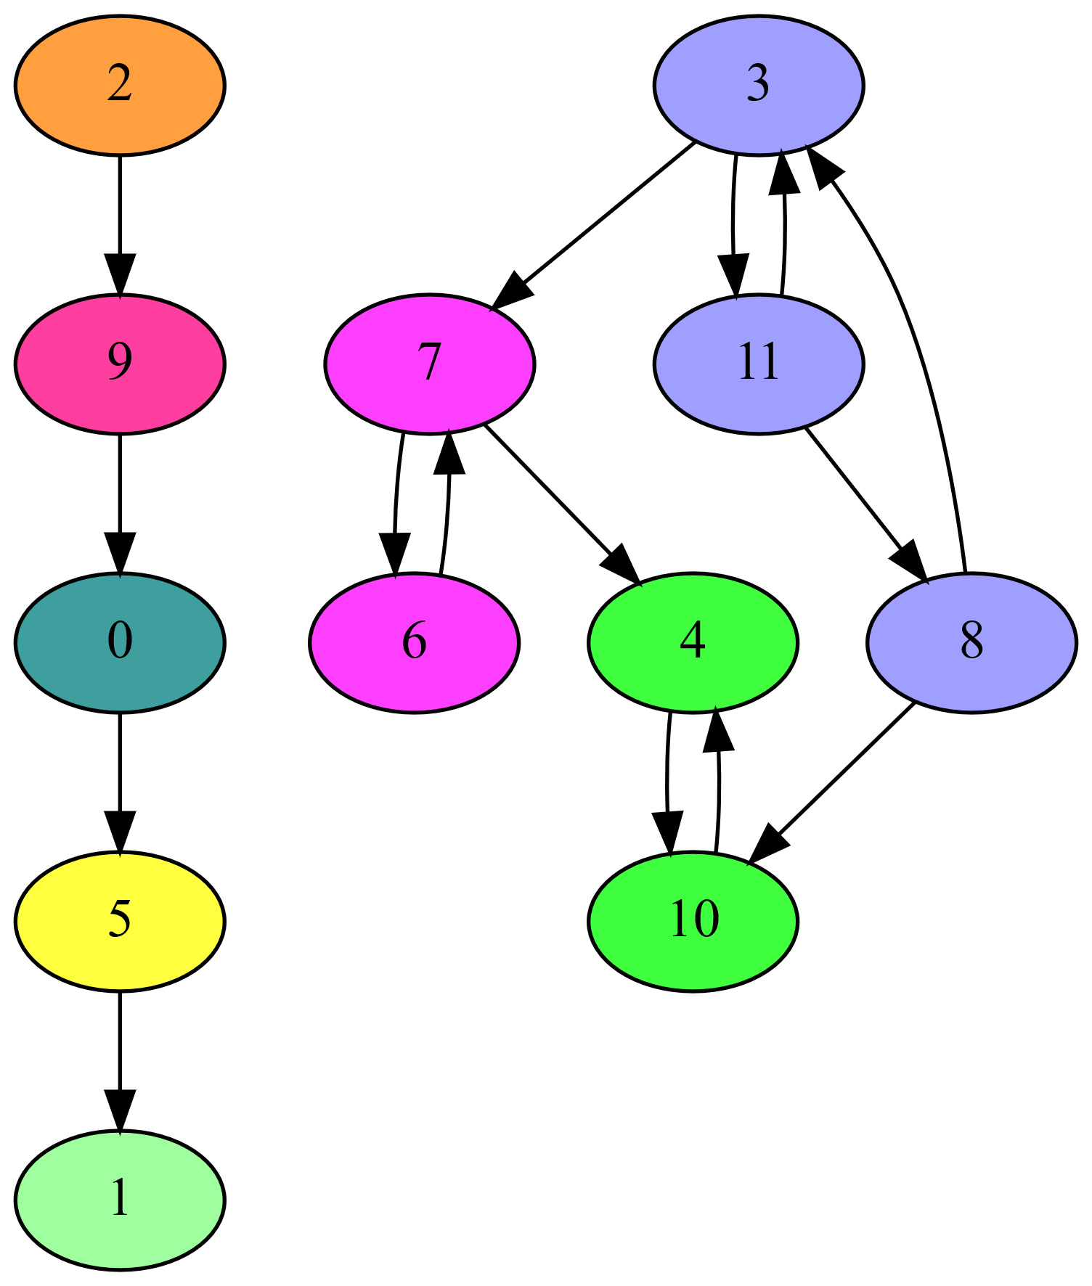
Parallel Forward-Backward Algorithm
Leading parallel SCC algorithms are based on Forward-Backward (FB) approach
Randomly select a pivot vertex
Perform parallel forward BFS
Perform parallel backward BFS
Result partitions graph into 4 subgraphs
Vertices reached by both BFSs (green)
Vertices only reached by fwd BFS (blue)
Vertices only reached by bwd BFS (yellow)
Vertices not reached by BFS (unshaded)
First set (green) is done (SCC of pivot)
Recurse on latter three sets
Independent, can be done in parallel

Slide 15
FB with Trim Optimizations
FB can be slow in presence of many small SCCs
Trim optimizations can help
Trim-1: detects some 1-vertex SCCs
Vertex with no in- or no out-edges
Trim-2: detects some 2-vertex SCCs
Any cyclically connected vertex pair with otherwise no in- or no out-edges
Trim-3: detects some 3-vertex SCCs
Any cyclically connected vertex triple with otherwise no in- or no out-edges
Detected based on a set of patterns
Trim steps may be iterated

Slide 16
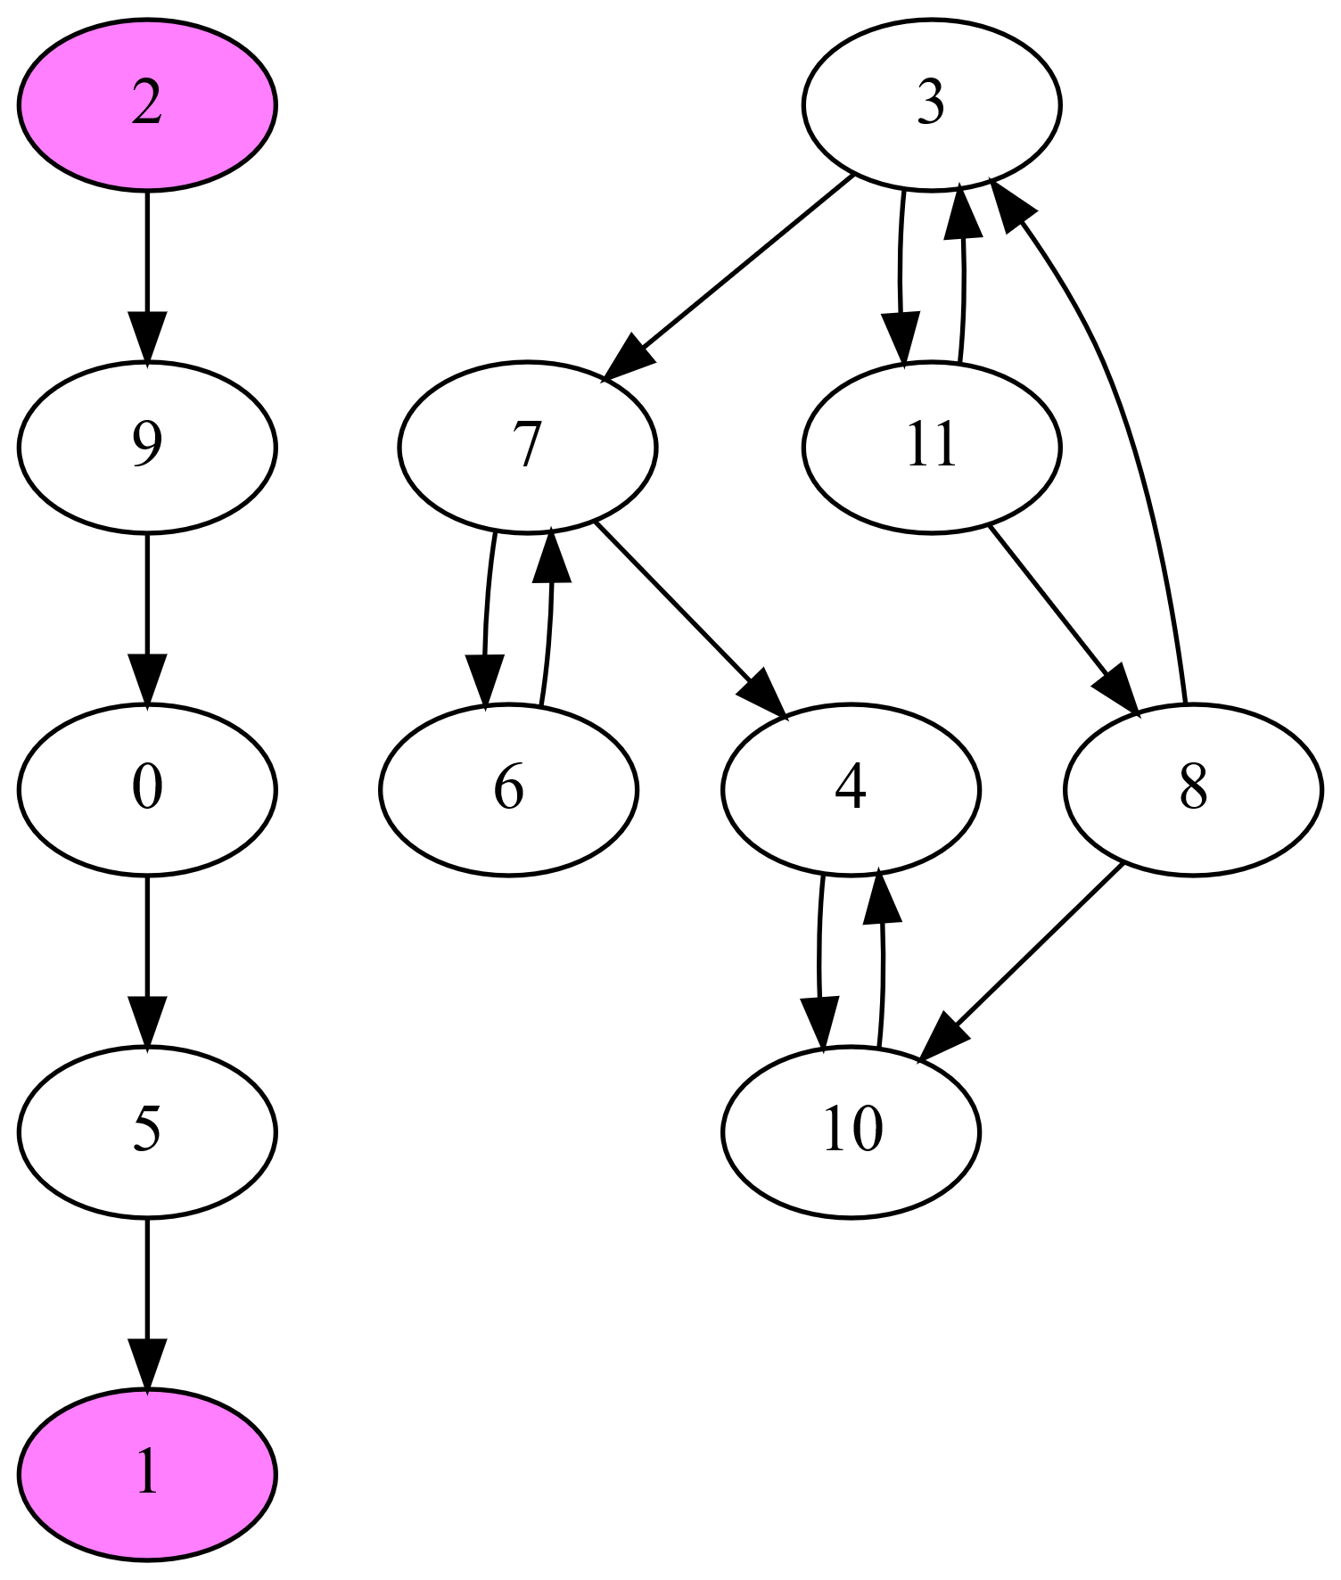
FB with Trim Optimizations
FB can be slow in presence of many small SCCs
Trim optimizations can help
Trim-1: detects some 1-vertex SCCs
Vertex with no in- or no out-edges
Trim-2: detects some 2-vertex SCCs
Any cyclically connected vertex pair with otherwise no in- or no out-edges
Trim-3: detects some 3-vertex SCCs
Any cyclically connected vertex triple with otherwise no in- or no out-edges
Detected based on a set of patterns
Trim steps may be iterated

Slide 17
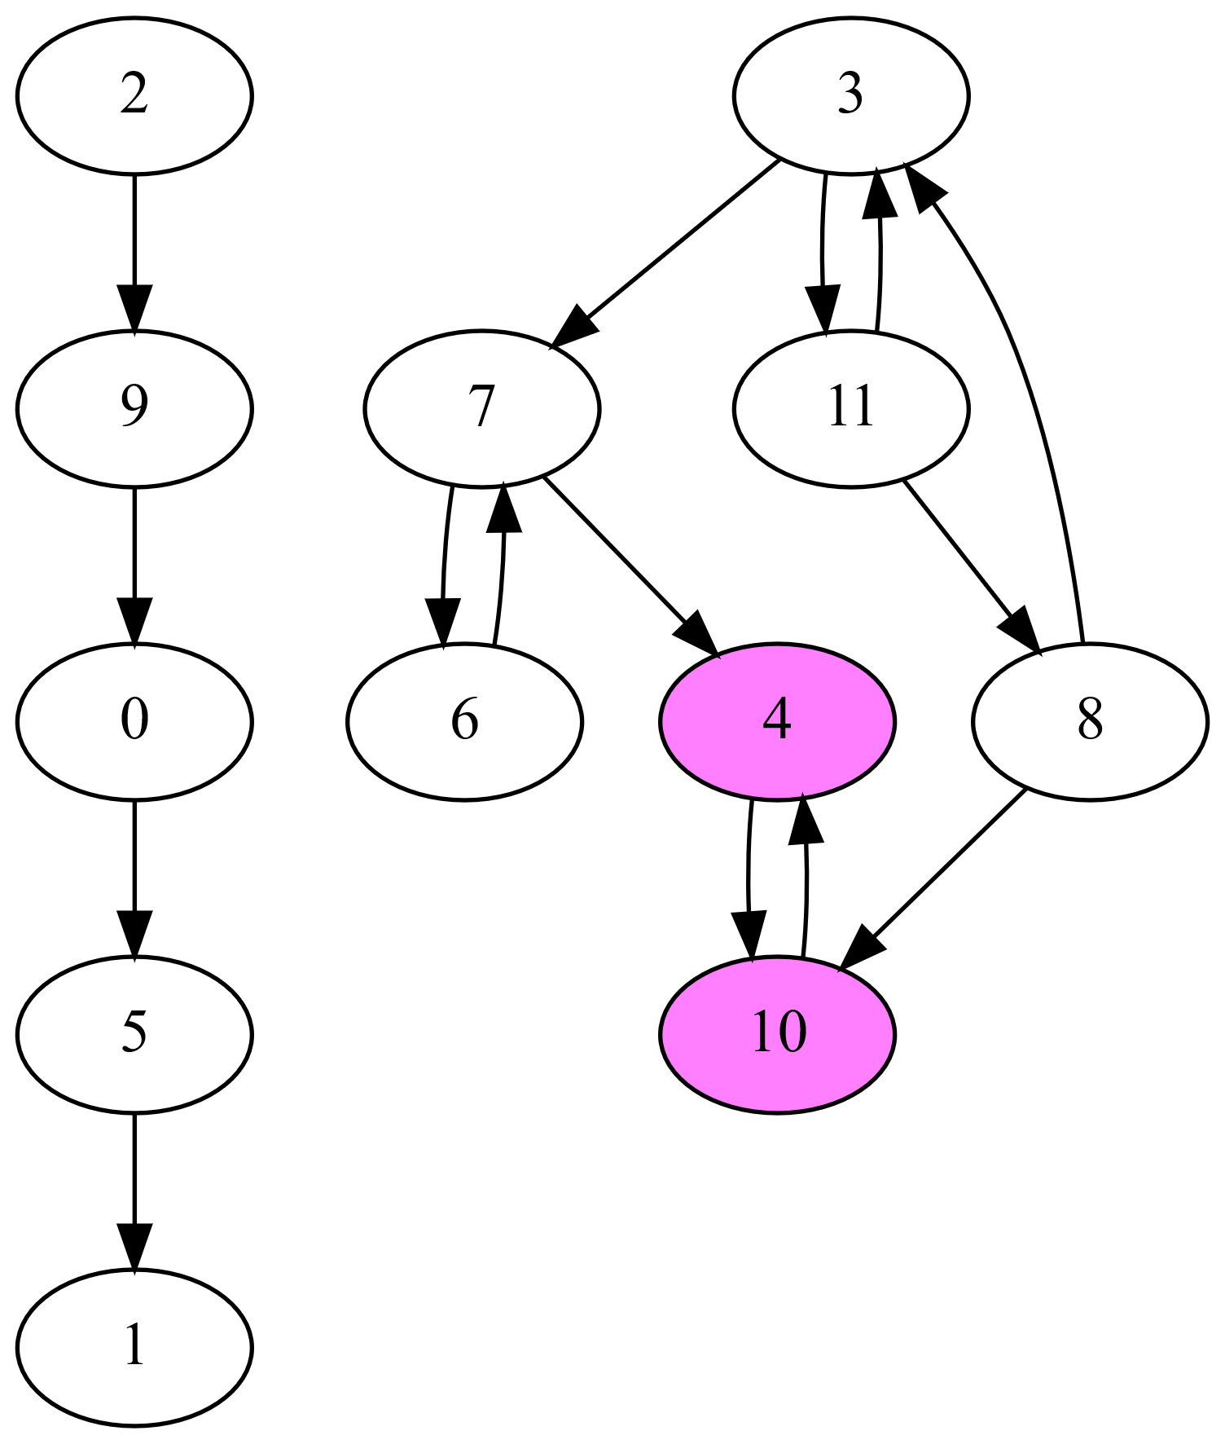
FB with Trim Optimizations
FB can be slow in presence of many small SCCs
Trim optimizations can help
Trim-1: detects some 1-vertex SCCs
Vertex with no in- or no out-edges
Trim-2: detects some 2-vertex SCCs
Any cyclically connected vertex pair with otherwise no in- or no out-edges
Trim-3: detects some 3-vertex SCCs
Any cyclically connected vertex triple with otherwise no in- or no out-edges
Detected based on a set of patterns
Trim steps may be iterated

Slide 18
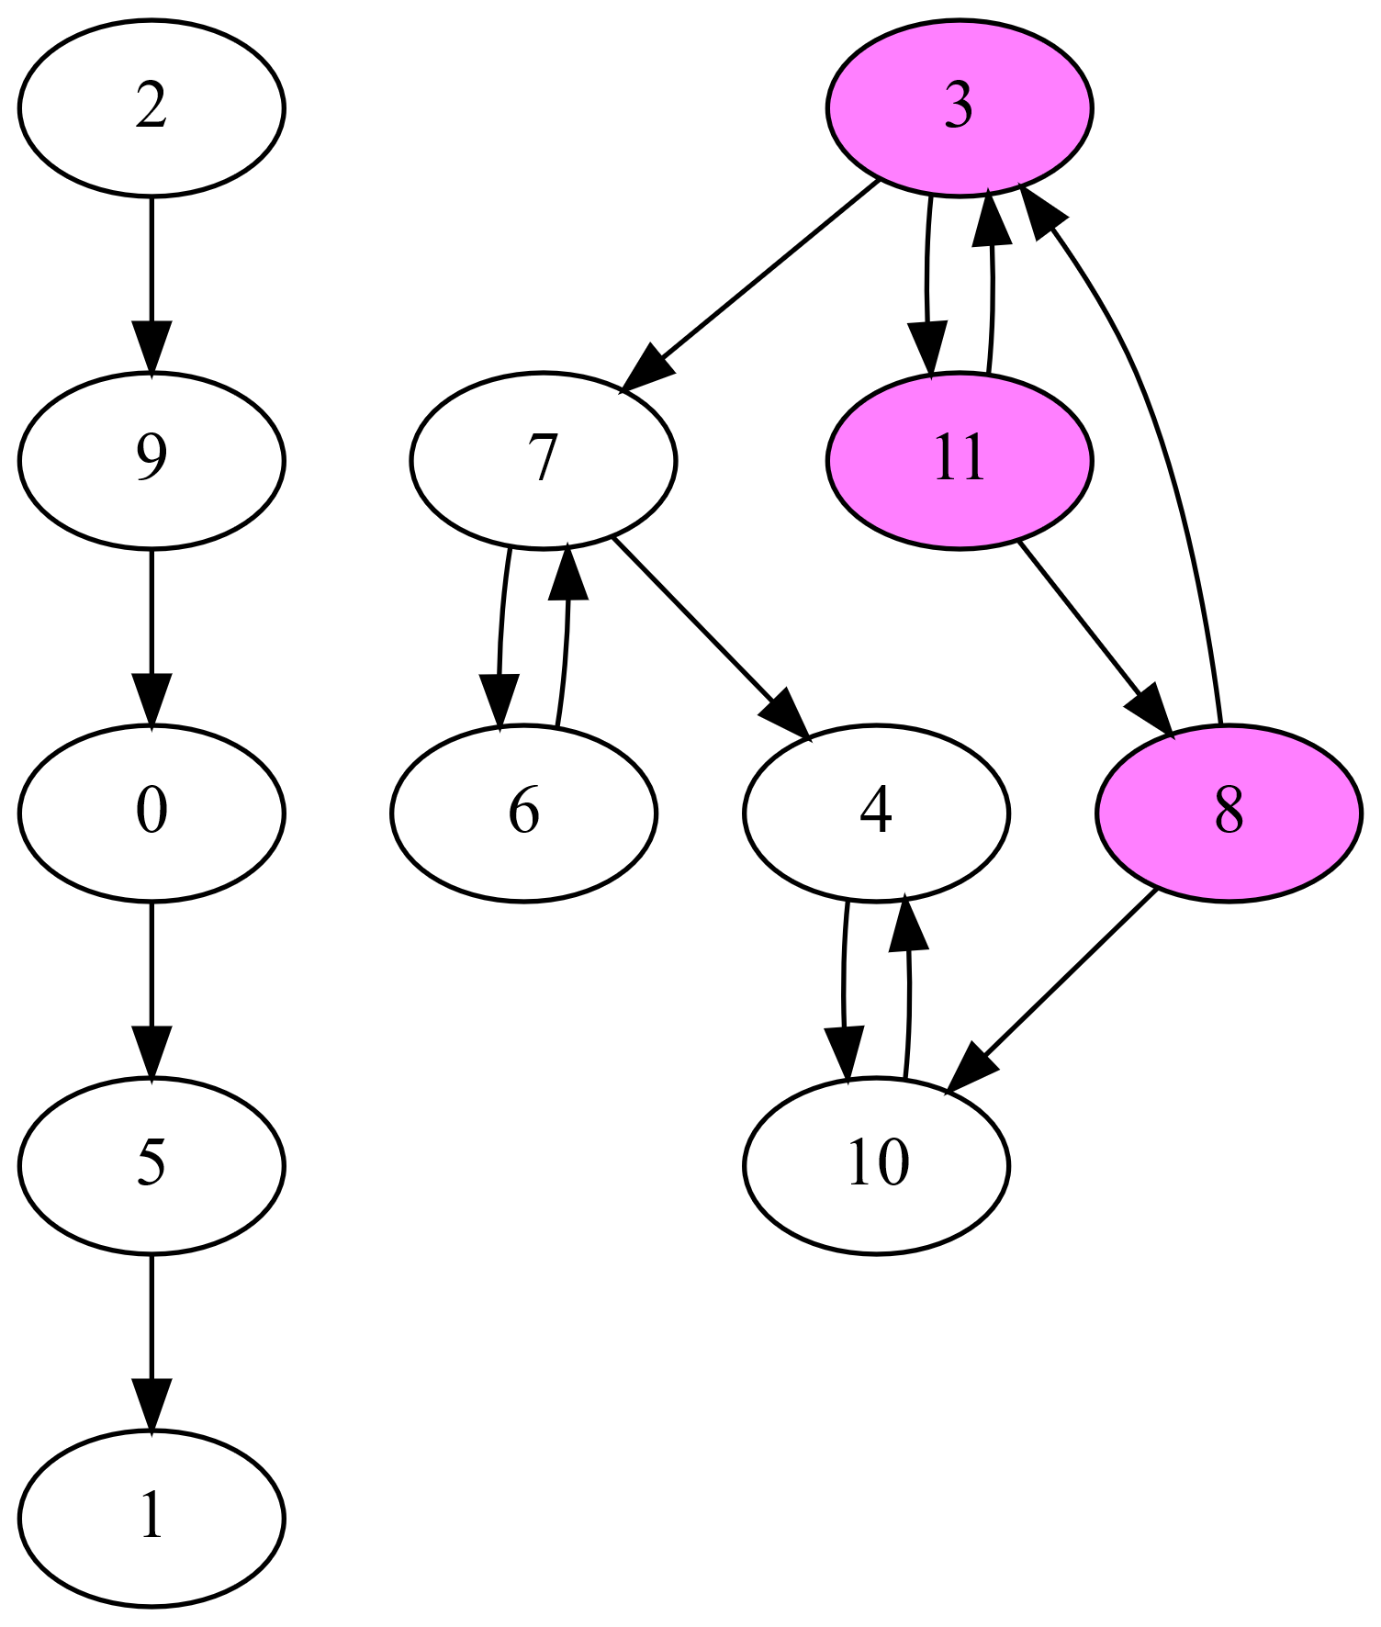
FB with Trim Optimizations
FB can be slow in presence of many small SCCs
Trim optimizations can help
Trim-1: detects some 1-vertex SCCs
Vertex with no in- or no out-edges
Trim-2: detects some 2-vertex SCCs
Any cyclically connected vertex pair with otherwise no in- or no out-edges
Trim-3: detects some 3-vertex SCCs
Any cyclically connected vertex triple with otherwise no in- or no out-edges
Detected based on a set of patterns
Trim steps may be iterated

Slide 19
FB with Trim Optimizations
FB can be slow in presence of many small SCCs
Trim optimizations can help
Trim-1: detects some 1-vertex SCCs
Vertex with no in- or no out-edges
Trim-2: detects some 2-vertex SCCs
Any cyclically connected vertex pair with otherwise no in- or no out-edges
Trim-3: detects some 3-vertex SCCs
Any cyclically connected vertex triple with otherwise no in- or no out-edges
Detected based on a set of patterns
Trim steps may be iterated

Slide 20

Problem
Many parallel SCC codes target power-law graphs
Often have a few high-degree vertices
Tend to have one large SCC and several small SCCs
Have shallow DAG when collapsing the SCCs
Mesh graphs from thermal radiative transfer sims
Have low-degree vertices
Have variable numbers and sizes of SCCs
Often have a deeper DAG when collapsing the SCCs
Prior parallel SCC codes are ineffective on meshes
Often slower than serial code

Slide 21
Our ECL-SCC Algorithm

Slide 22
Our Parallel ECL-SCC Algorithm
Computes two signature values for each vertex
𝑣_{𝑖𝑛}: max reachable vertex ID on incoming paths
𝑣_{𝑜𝑢𝑡}: max reachable vertex ID on outgoing paths
Step 1: signature initialization
Initializes signature values to vertex ID
Step 2: maximum-value propagation
Updates signatures until fixed-point reached
𝑣_{𝑖𝑛} = max of itself and 𝑣_{𝑖𝑛} of in-neighbors
𝑣_{𝑜𝑢𝑡} = max of itself and 𝑣_{𝑜𝑢𝑡} of out-neighbors
Step 3: edge removal
Delete edges between differing signatures
Repeat above steps until every vertex satisfies 𝑣_{𝑖𝑛} = 𝑣_{out}

Slide 23
Our Parallel ECL-SCC Algorithm
Computes two signature values for each vertex
𝑣_{𝑖𝑛}: max reachable vertex ID on incoming paths
𝑣_{𝑜𝑢𝑡}: max reachable vertex ID on outgoing paths
Step 1: signature initialization
Initializes signature values to vertex ID
Step 2: maximum-value propagation
Updates signatures until fixed-point reached
𝑣_{𝑖𝑛} = max of itself and 𝑣_{𝑖𝑛} of in-neighbors
𝑣_{𝑜𝑢𝑡} = max of itself and 𝑣_{𝑜𝑢𝑡} of out-neighbors
Step 3: edge removal
Delete edges between differing signatures
Repeat above steps until every vertex satisfies 𝑣_{𝑖𝑛} = 𝑣_{out}

Slide 24
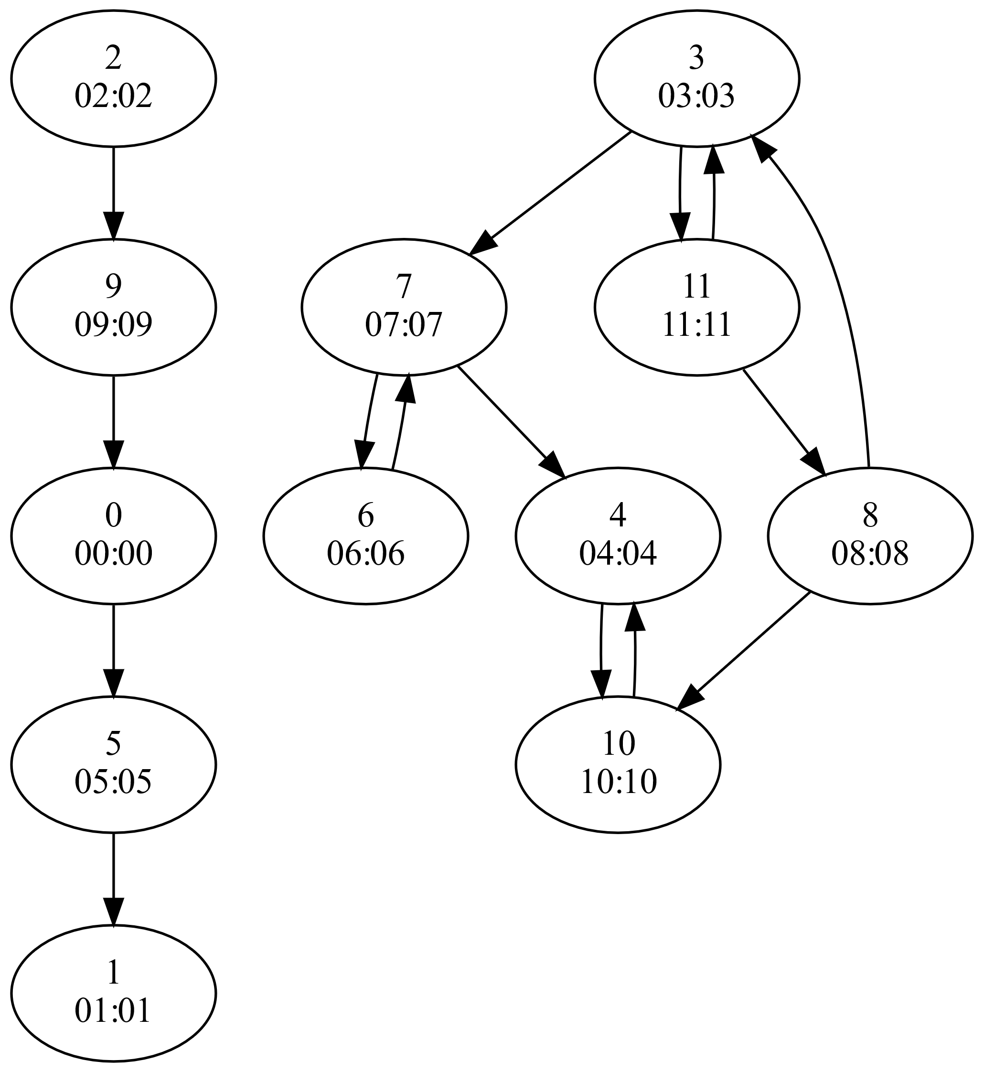
Our Parallel ECL-SCC Algorithm
Computes two signature values for each vertex
𝑣_{𝑖𝑛}: max reachable vertex ID on incoming paths
𝑣_{𝑜𝑢𝑡}: max reachable vertex ID on outgoing paths
Step 1: signature initialization
Initializes signature values to vertex ID
Step 2: maximum-value propagation
Updates signatures until fixed-point reached
𝑣_{𝑖𝑛} = max of itself and 𝑣_{𝑖𝑛} of in-neighbors
𝑣_{𝑜𝑢𝑡} = max of itself and 𝑣_{𝑜𝑢𝑡} of out-neighbors
Step 3: edge removal
Delete edges between differing signatures
Repeat above steps until every vertex satisfies 𝑣_{𝑖𝑛} = 𝑣_{out}

Slide 25
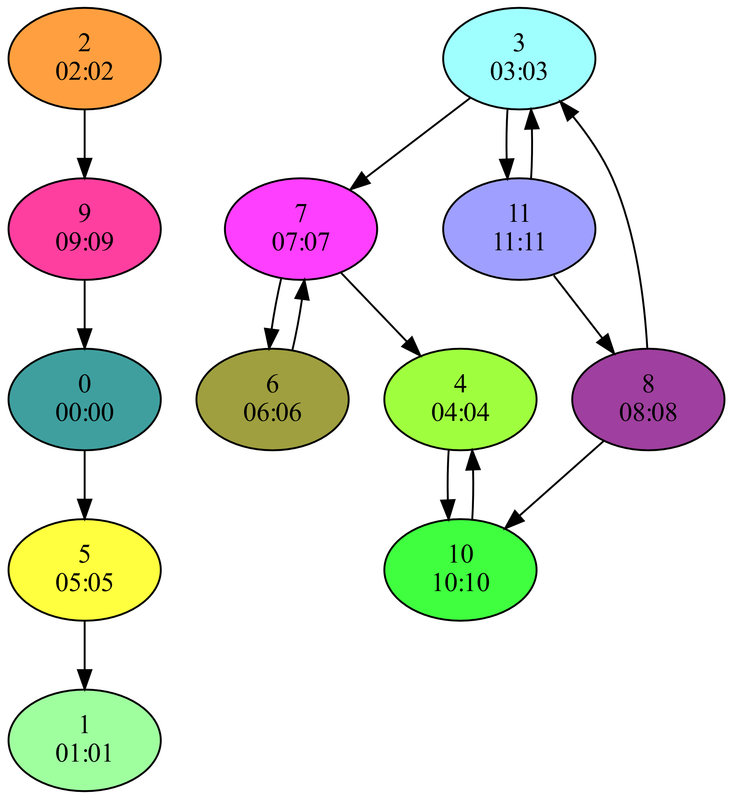
Our Parallel ECL-SCC Algorithm
Computes two signature values for each vertex
𝑣_{𝑖𝑛}: max reachable vertex ID on incoming paths
𝑣_{𝑜𝑢𝑡}: max reachable vertex ID on outgoing paths
Step 1: signature initialization
Initializes signature values to vertex ID
Step 2: maximum-value propagation
Updates signatures until fixed-point reached
𝑣_{𝑖𝑛} = max of itself and 𝑣_{𝑖𝑛} of in-neighbors
𝑣_{𝑜𝑢𝑡} = max of itself and 𝑣_{𝑜𝑢𝑡} of out-neighbors
Step 3: edge removal
Delete edges between differing signatures
Repeat above steps until every vertex satisfies 𝑣_{𝑖𝑛} = 𝑣_{out}

Slide 26
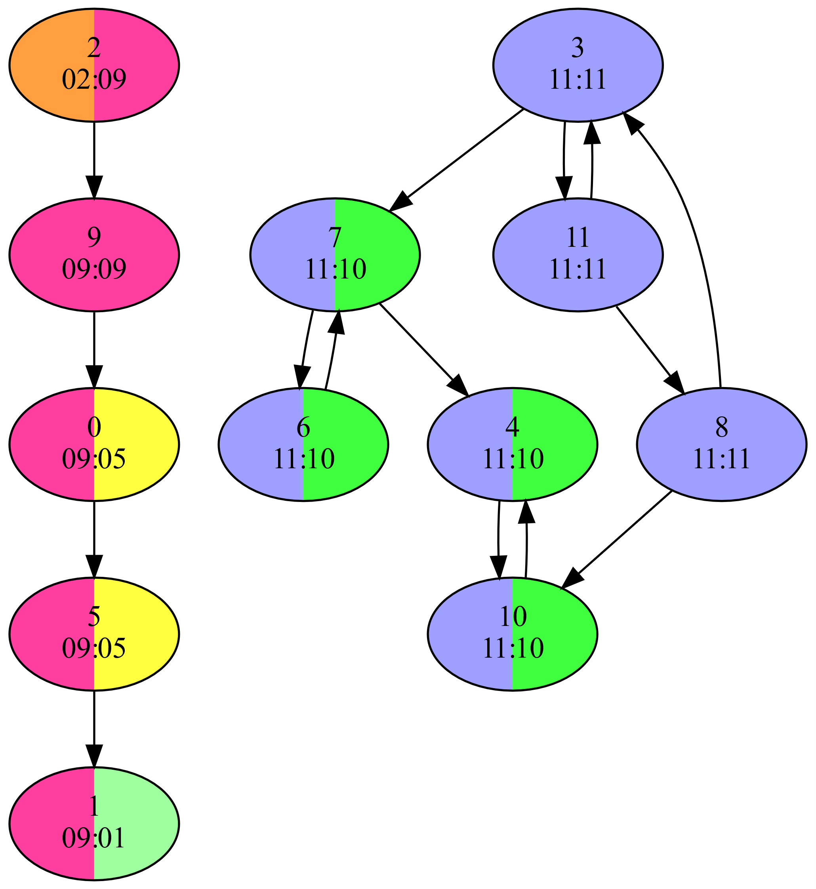
Our Parallel ECL-SCC Algorithm
Computes two signature values for each vertex
𝑣_{𝑖𝑛}: max reachable vertex ID on incoming paths
𝑣_{𝑜𝑢𝑡}: max reachable vertex ID on outgoing paths
Step 1: signature initialization
Initializes signature values to vertex ID
Step 2: maximum-value propagation
Updates signatures until fixed-point reached
𝑣_{𝑖𝑛} = max of itself and 𝑣_{𝑖𝑛} of in-neighbors
𝑣_{𝑜𝑢𝑡} = max of itself and 𝑣_{𝑜𝑢𝑡} of out-neighbors
Step 3: edge removal
Delete edges between differing signatures
Repeat above steps until every vertex satisfies 𝑣_{𝑖𝑛} = 𝑣_{out}

Slide 27
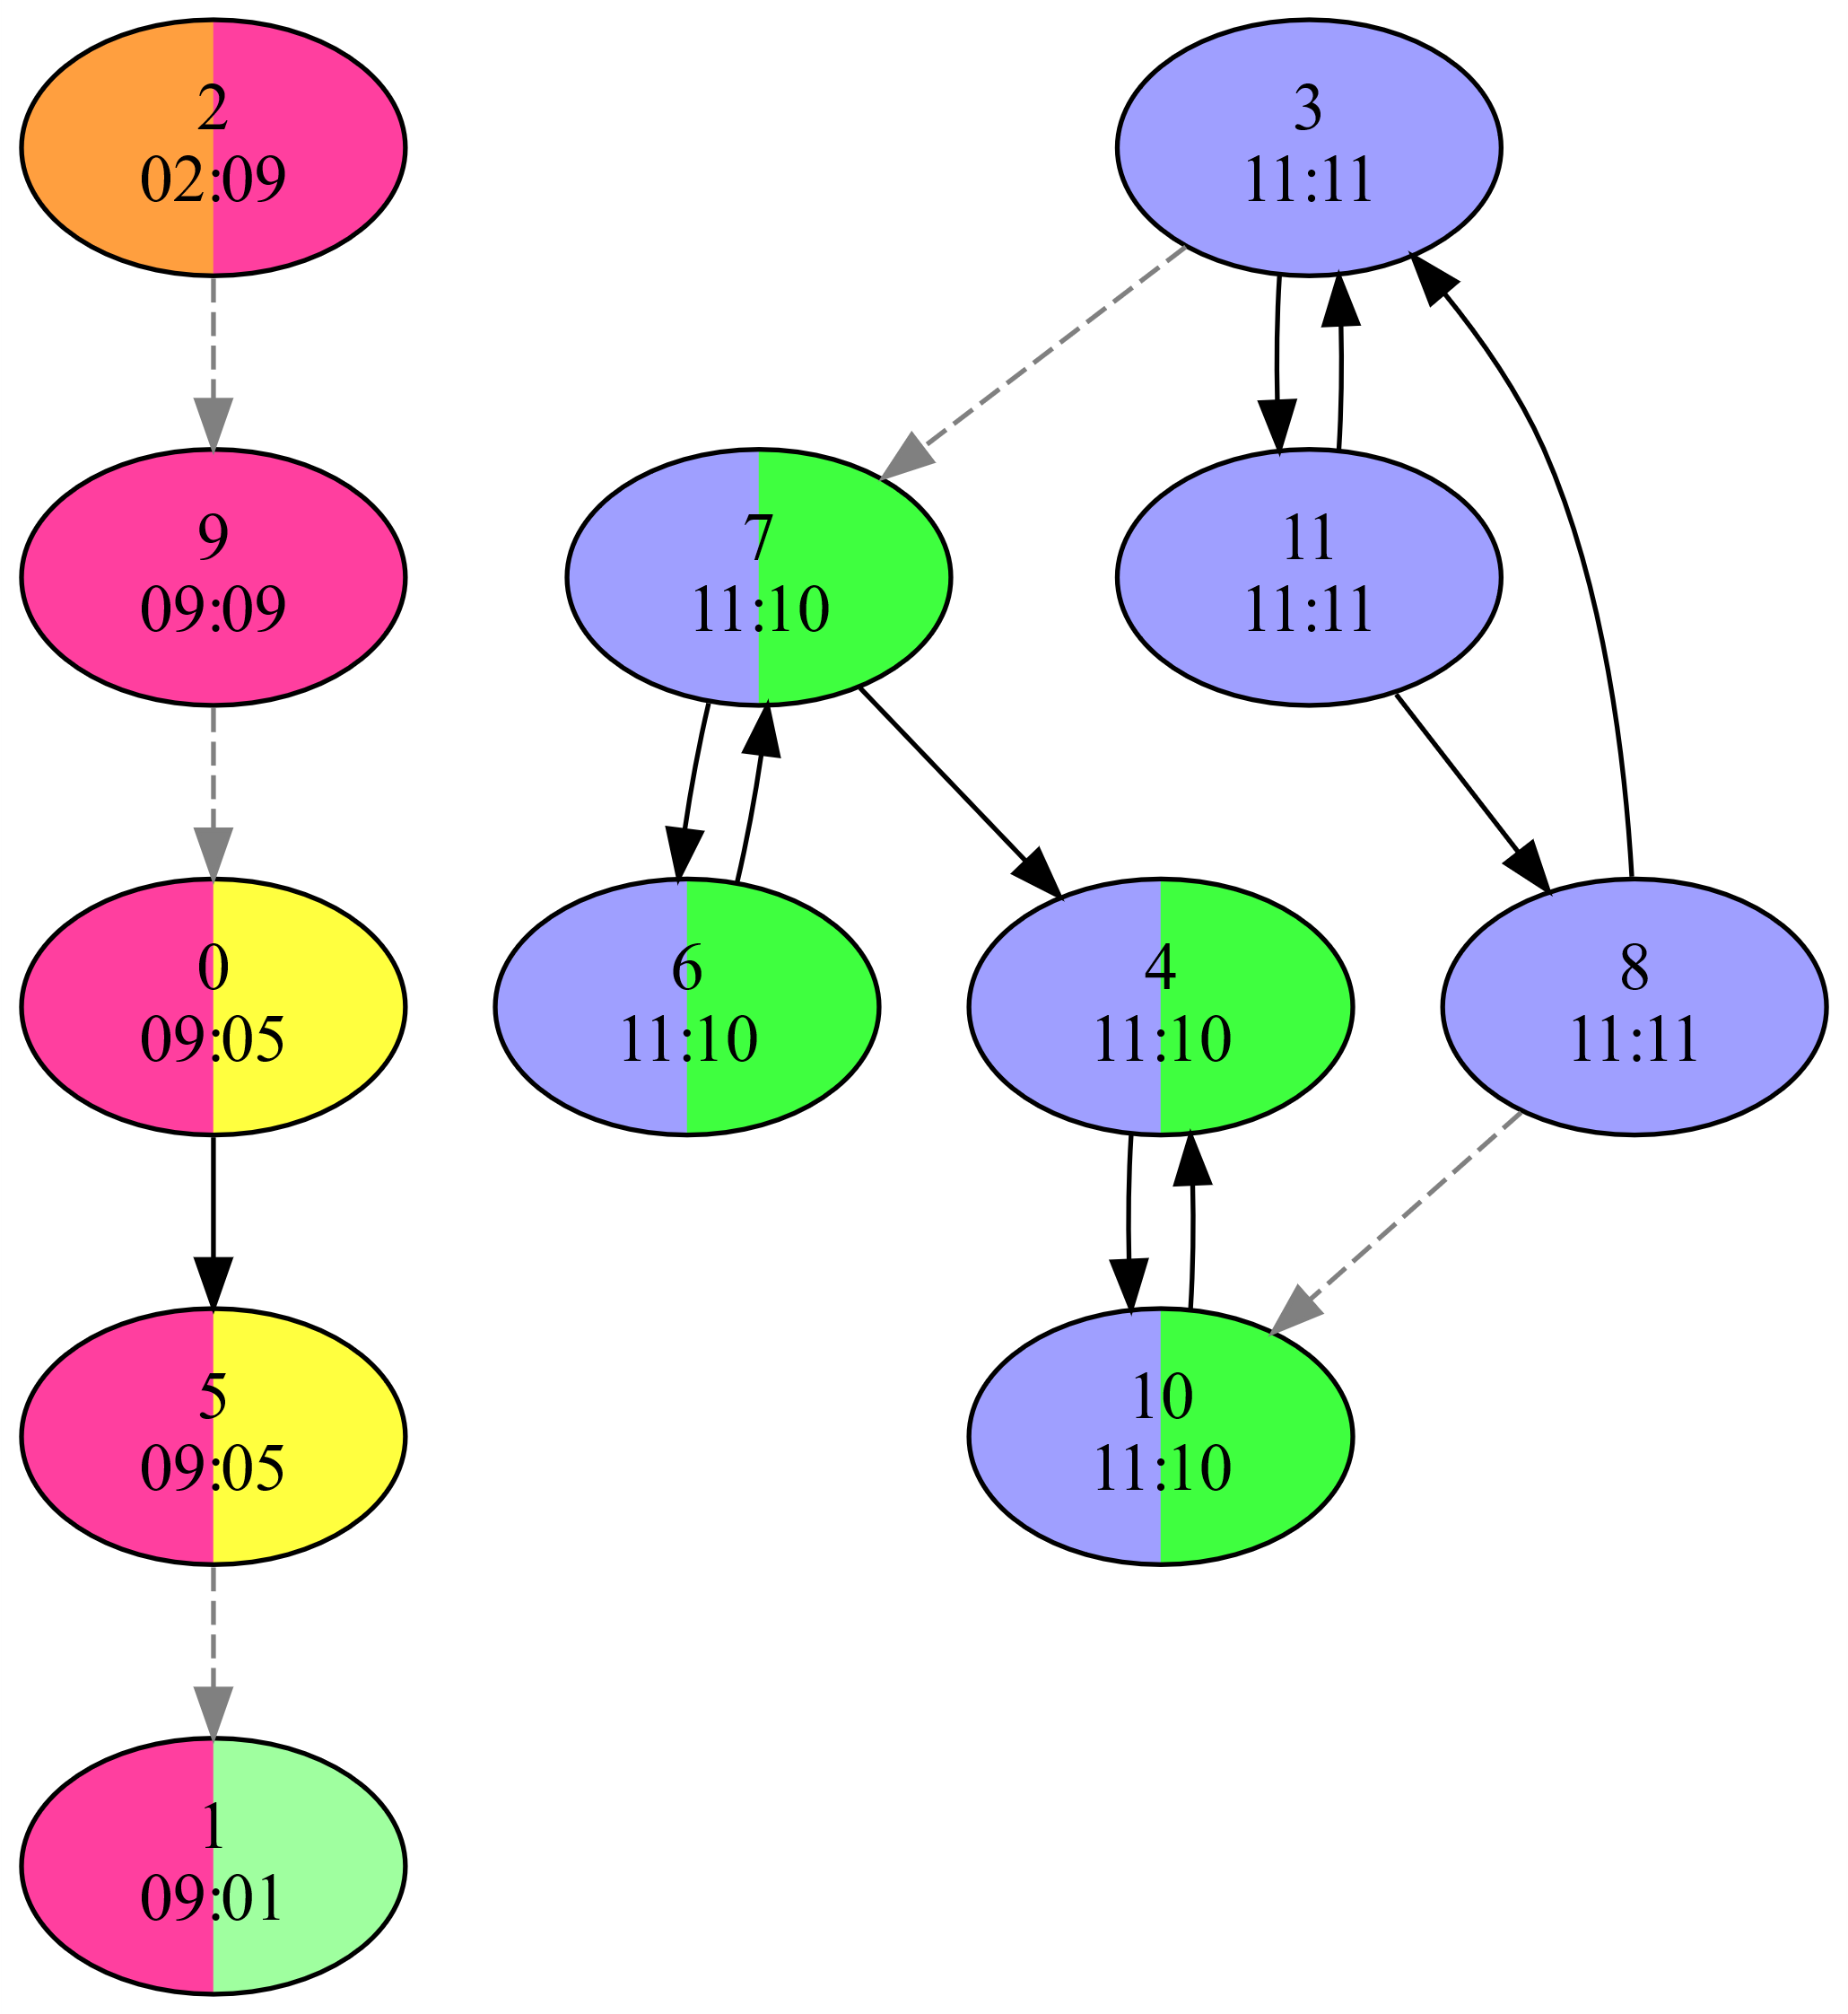
Our Parallel ECL-SCC Algorithm
Computes two signature values for each vertex
𝑣_{𝑖𝑛}: max reachable vertex ID on incoming paths
𝑣_{𝑜𝑢𝑡}: max reachable vertex ID on outgoing paths
Step 1: signature initialization
Initializes signature values to vertex ID
Step 2: maximum-value propagation
Updates signatures until fixed-point reached
𝑣_{𝑖𝑛} = max of itself and 𝑣_{𝑖𝑛} of in-neighbors
𝑣_{𝑜𝑢𝑡} = max of itself and 𝑣_{𝑜𝑢𝑡} of out-neighbors
Step 3: edge removal
Delete edges between differing signatures
Repeat above steps until every vertex satisfies 𝑣_{𝑖𝑛} = 𝑣_{out}

Slide 28
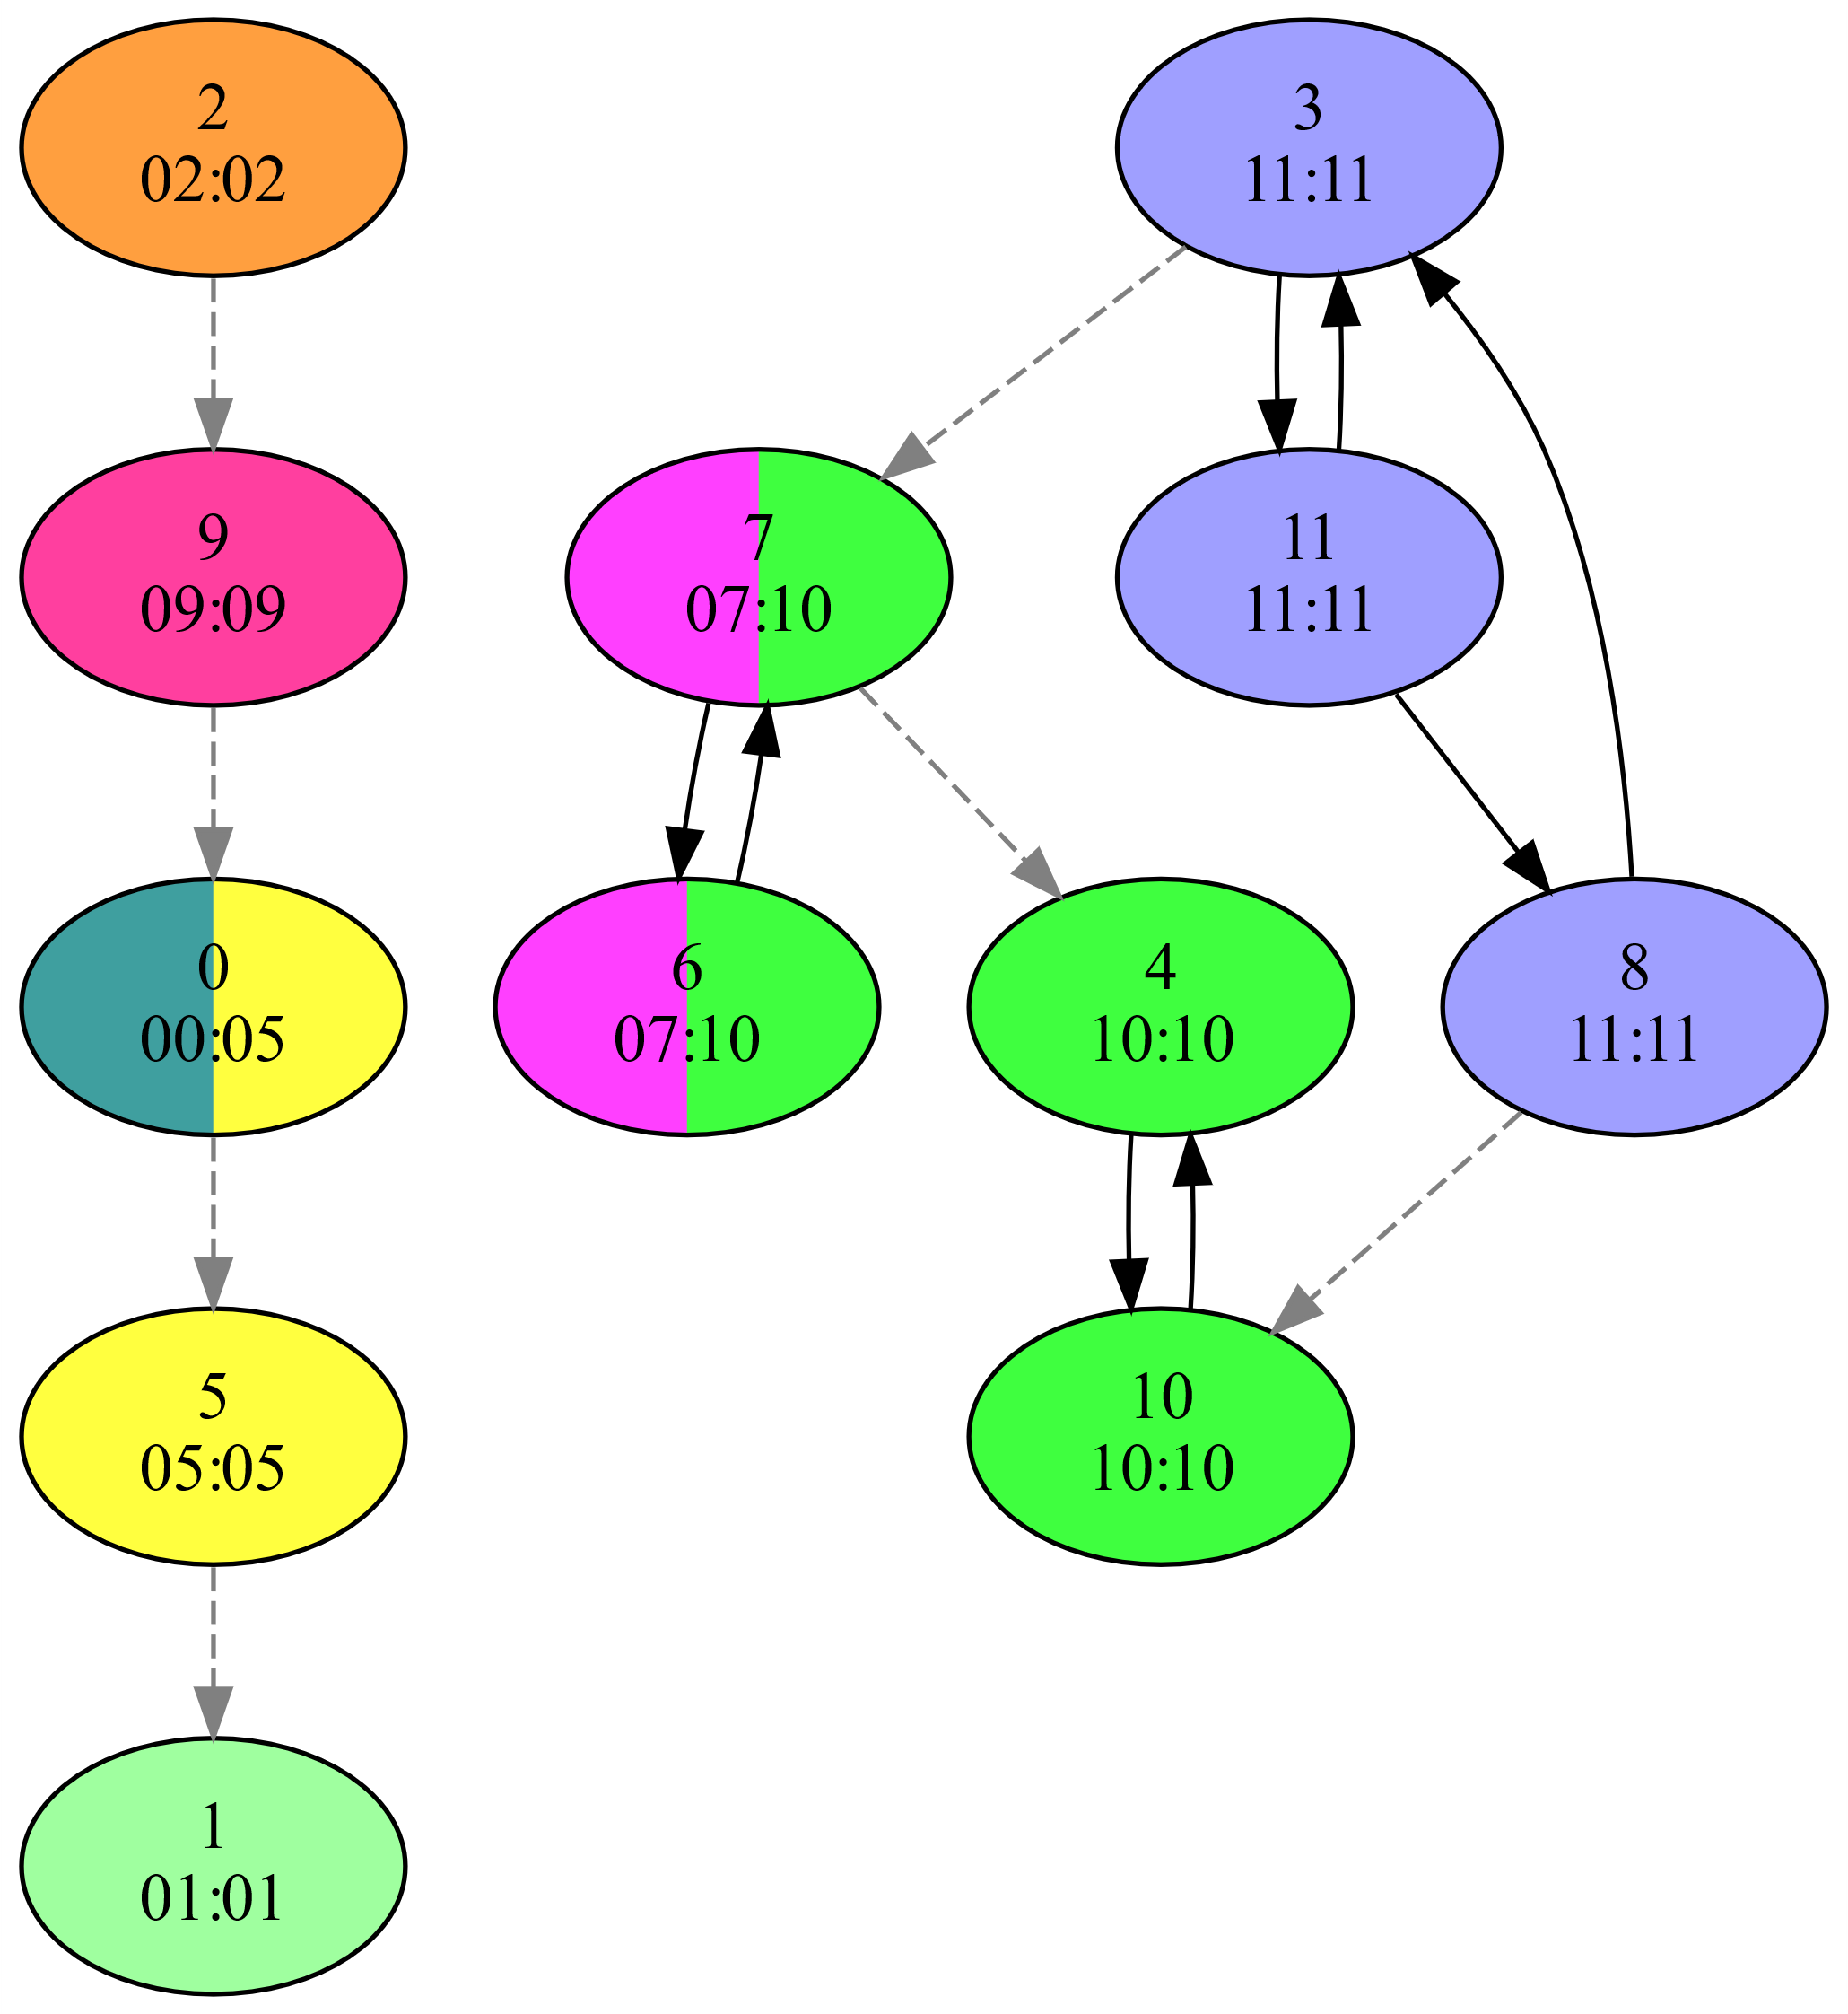
Our Parallel ECL-SCC Algorithm
Computes two signature values for each vertex
𝑣_{𝑖𝑛}: max reachable vertex ID on incoming paths
𝑣_{𝑜𝑢𝑡}: max reachable vertex ID on outgoing paths
Step 1: signature initialization
Initializes signature values to vertex ID
Step 2: maximum-value propagation
Updates signatures until fixed-point reached
𝑣_{𝑖𝑛} = max of itself and 𝑣_{𝑖𝑛} of in-neighbors
𝑣_{𝑜𝑢𝑡} = max of itself and 𝑣_{𝑜𝑢𝑡} of out-neighbors
Step 3: edge removal
Delete edges between differing signatures
Repeat above steps until every vertex satisfies 𝑣_{𝑖𝑛} = 𝑣_{out}

Slide 29
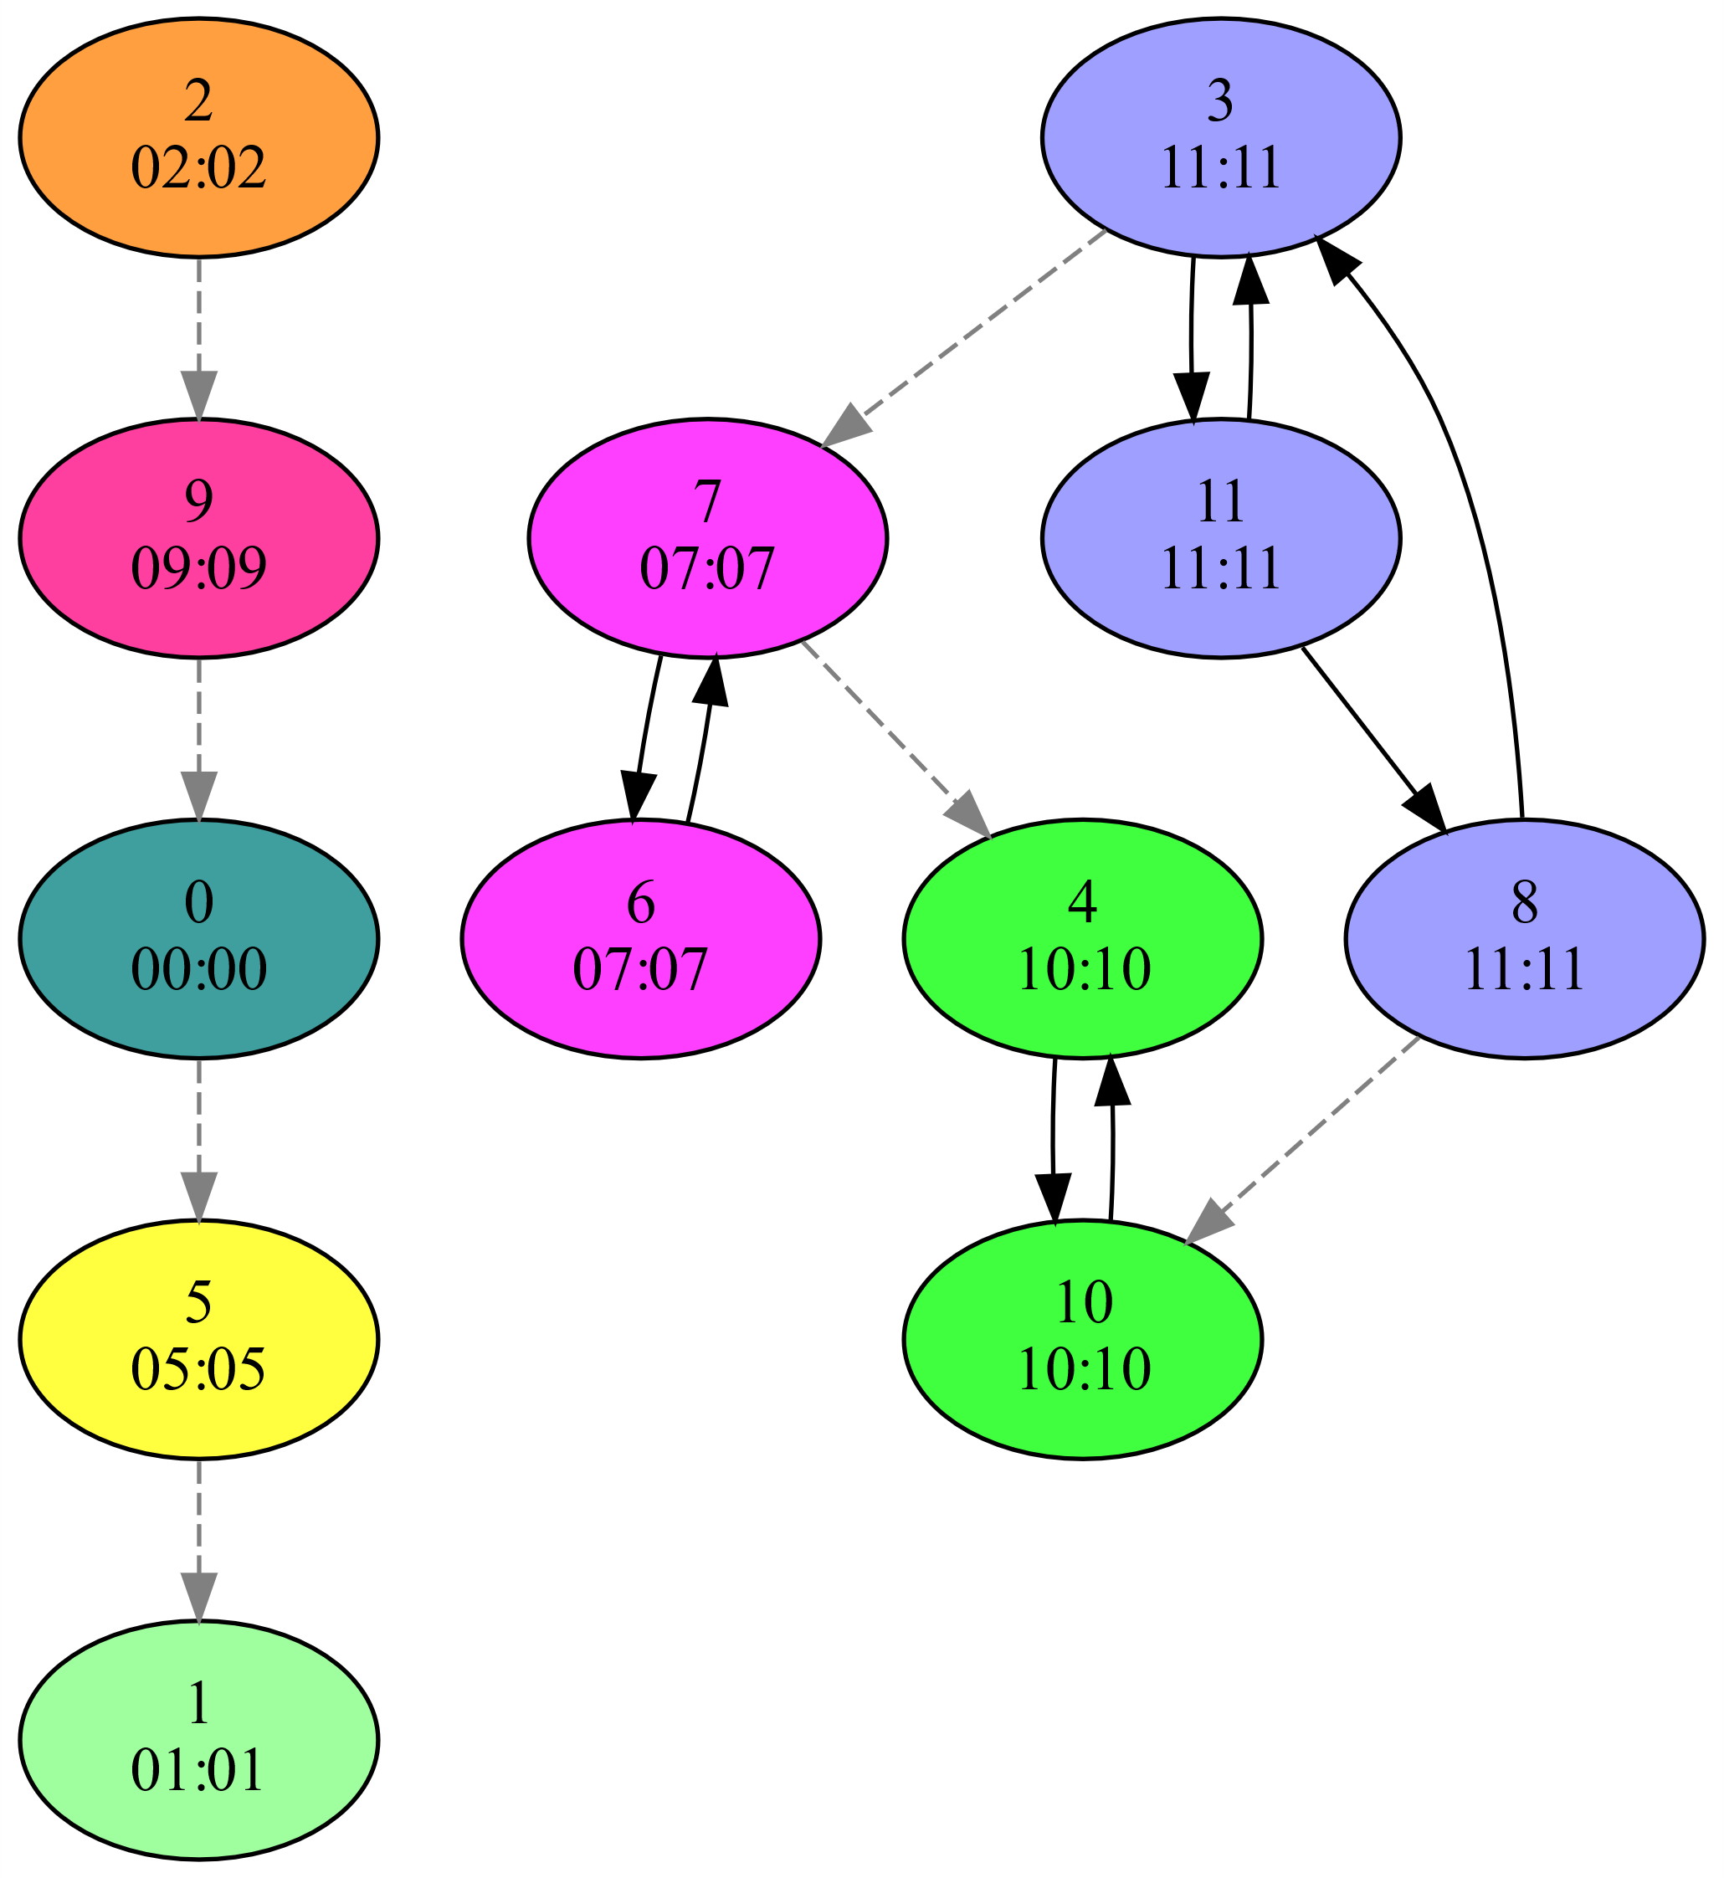
Our Parallel ECL-SCC Algorithm
Computes two signature values for each vertex
𝑣_{𝑖𝑛}: max reachable vertex ID on incoming paths
𝑣_{𝑜𝑢𝑡}: max reachable vertex ID on outgoing paths
Step 1: signature initialization
Initializes signature values to vertex ID
Step 2: maximum-value propagation
Updates signatures until fixed-point reached
𝑣_{𝑖𝑛} = max of itself and 𝑣_{𝑖𝑛} of in-neighbors
𝑣_{𝑜𝑢𝑡} = max of itself and 𝑣_{𝑜𝑢𝑡} of out-neighbors
Step 3: edge removal
Delete edges between differing signatures
Repeat above steps until every vertex satisfies 𝑣_{𝑖𝑛} = 𝑣_{out}

Slide 30
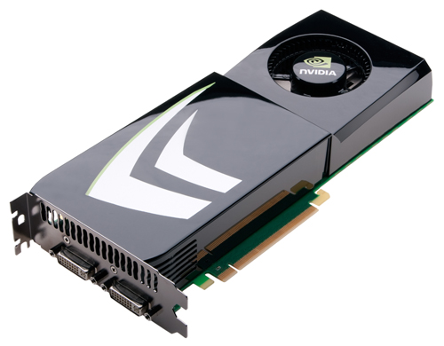
ECL-SCC Parallelization
Algorithm designed to be parallelism friendly
No depth- or breadth-first search
Starts out with high degree of parallelism
Uses every vertex simultaneously as a “pivot”
GPU friendly
No recursion, little or no explicit synchronization
Initialization is embarrassingly parallel
Vertex-ID propagation is atomic-free
Edge removal uses atomic operations

Slide 31

ECL-SCC Performance Optimization
Vertex-ID propagation
Employs “path compression” idea from union-find
Enables faster label propagation
Uses asynchronous persistent-thread approach
Reduces kernel launch overhead if many iterations
Edge removal
ECL-SCC uses worklist (WL) to hold edges
Edge removal deletes edges from WL, not from graph
Also removes edges within detected SCCs from WL
Eliminates unnecessary work and reduces iterations

Slide 32
Complexity Analysis
Memory
Signatures: 𝑂(|𝑉|) and worklist: 𝑂(|𝐸|)
Work
Phase 1: 𝑂(|𝑉|), Phase 2: 𝑂(𝑐|𝐸|), Phase 3: 𝑂(|𝐸|), c = longest cycle length
Phases iterate up to 𝑑 times, d = depth of DAG
Worst case: 𝑂(𝑑𝑐|𝐸| + 𝑑|𝑉|))
Expected work: 𝑂(𝑙𝑜𝑔(𝑑) 𝑙𝑜𝑔(𝑐) |𝐸| + 𝑙𝑜𝑔(𝑑) |𝑉|)
Process cycles in 𝑙𝑜𝑔(𝑐) steps using “path compression”
Halve DAG depth in each iteration (if vertex IDs are random)

Slide 33
Results

Slide 34
Experimental Methodology
Two CPU systems
16-core 3.5 GHz Ryzen Threadripper 2950X (32 threads)
Dual 16-core 2.9 GHz Xeon Gold 6226R (64 threads)
Two GPUs
Volta-based Titan V: 5120 PEs, 80 SMs, 12 GB memory
Ampere-based A100: 6912 PEs, 108 SMs, 40 GB memory
OS and compilers
Fedora 37 operating system
nvcc 12.0 with “-O3 -arch=sm_80” for A100
gcc/g++ 12.2.1 using -O3 -fopenmp”

Slide 35
Experimental Methodology
Performance comparison
SCC-GPU, fastest GPU code
iSpan, fastest parallel CPU code
Tarjan, fastest serial CPU code
Metrics
SCC computation time
Excluding reading in graph, writing result, and verification
Median of 9 runs (except for some slow iSpan runs)
Throughput = #graph vertices / computation time
Verification
Compared solution of ECL-SCC to Tarjan’s algorithm

Slide 36
Power-law Graphs
10 graphs from SuiteSparse Matrix Collection
Also used in related work
Most have shallow DAG when collapsing SCCs
Most have some high-degree vertices
Most have one very large SCC

Slide 37
Small & Large Mesh Graphs
166 small and 205 large meshes
Constructed using MFEM
Low-order tet. & hex. elements
Curved high-order elements
Relatively deep DAGs when collapsing SCCs
None have high-degree vertices
SCC sizes vary greatly
Present averages over all ordinates

Slide 38
Throughput on Power-law Graphs
Our ECL-SCC code is fastest on 6 of 10 graphs
Geometric mean speedup is >2× over GPU-SCC and iSpan and >20× over Tarjan
iSpan (CPU) code is fastest on 4 graphs
GPU-SCC code is faster on 1 graph

Slide 39
Throughput on Small Mesh Graphs
Our ECL-SCC code is fastest on all small mesh groups except for beam-hex group
Serial Tarjan is second fastest, >4× faster than GPU-SCC and >2800× faster than iSpan
Beam-hex has only SCCs of size 1, GPU-SCC only uses Trim-1 phase on these inputs
Geometric mean speedup is 6.5× over GPU-SCC, 4400× over iSpan, 1.6× over Tarjan
Tarjan’s throughput is higher on meshes; other codes’ through-puts are lower on meshes

Slide 40
Throughput on Large Mesh Graphs
Serial Tarjan is again second fastest, outperforming prior parallel CPU and GPU codes
Our ECL-SCC code is fastest on all large mesh groups except for mobius-strip group
The klein-bottle and twist-hex graphs have one large SCC and a shallow DAG
Geometric mean speedup is 8.4× over GPU-SCC, 1100× over iSpan, 1.6× over Tarjan
Mobius-strip has both one very large SCC and the deepest DAG

Slide 41


Summary
ECL-SCC
New GPU algorithm to detect SCCs
Uses maximum vertex-ID propagation and edge removal
Particularly effective on graphs with smaller SCCs and medium DAG depth (e.g., mesh graphs)
Tarjan faster on graphs with large SCC and high DAG depth
iSpan faster on graphs with large SCC and low DAG depth
Our CUDA implementation on mesh graphs
6.5× faster that the fastest GPU code
Only studied code that is faster than serial Tarjan

Slide 42

Thank you!
Acknowledgments
DOE, NSF, NVIDIA
Contact information
burtscher@txstate.edu
Web and github pages (paper and code)
https://cs.txstate.edu/~burtscher/research/ECL-SCC/
https://github.com/burtscher/ECL-SCC

Slide 44
Optimization Evaluation
Path compression and asynchronous operation help on all three types of input graph
Persistent threads boost the performance on the power-law graphs but hurt on the mesh graphs
These optimizations together more than double the throughput of ECL-SCC

Slide 45
Propagation Step Guarantees
Signature
All vertices in an SCC must end up with same signature since there is a cycle
Proof by contradiction
Convergence
Guaranteed to terminate as max is monotonic and vertex IDs are finite
Can only increase or stay the same in each iteration
Capped by highest ID in graph

Slide 46
Correctness & Convergence
Initially, SCCs are clustered together
One SCC in each cluster must contain highest ID vertex of the cluster (due to uniqueness of IDs)
Ancestor SCCs cannot have this ID in in_{max} values
Descendant SCCs cannot have it in out_{max} values
Therefore, at least this SCC will be separated out
Remaining SCCs will be separated out in same or later iterations
After some iterations, all SCCs are separated out
Final signature is maxID : maxID, unique to each SCC

Slide 47
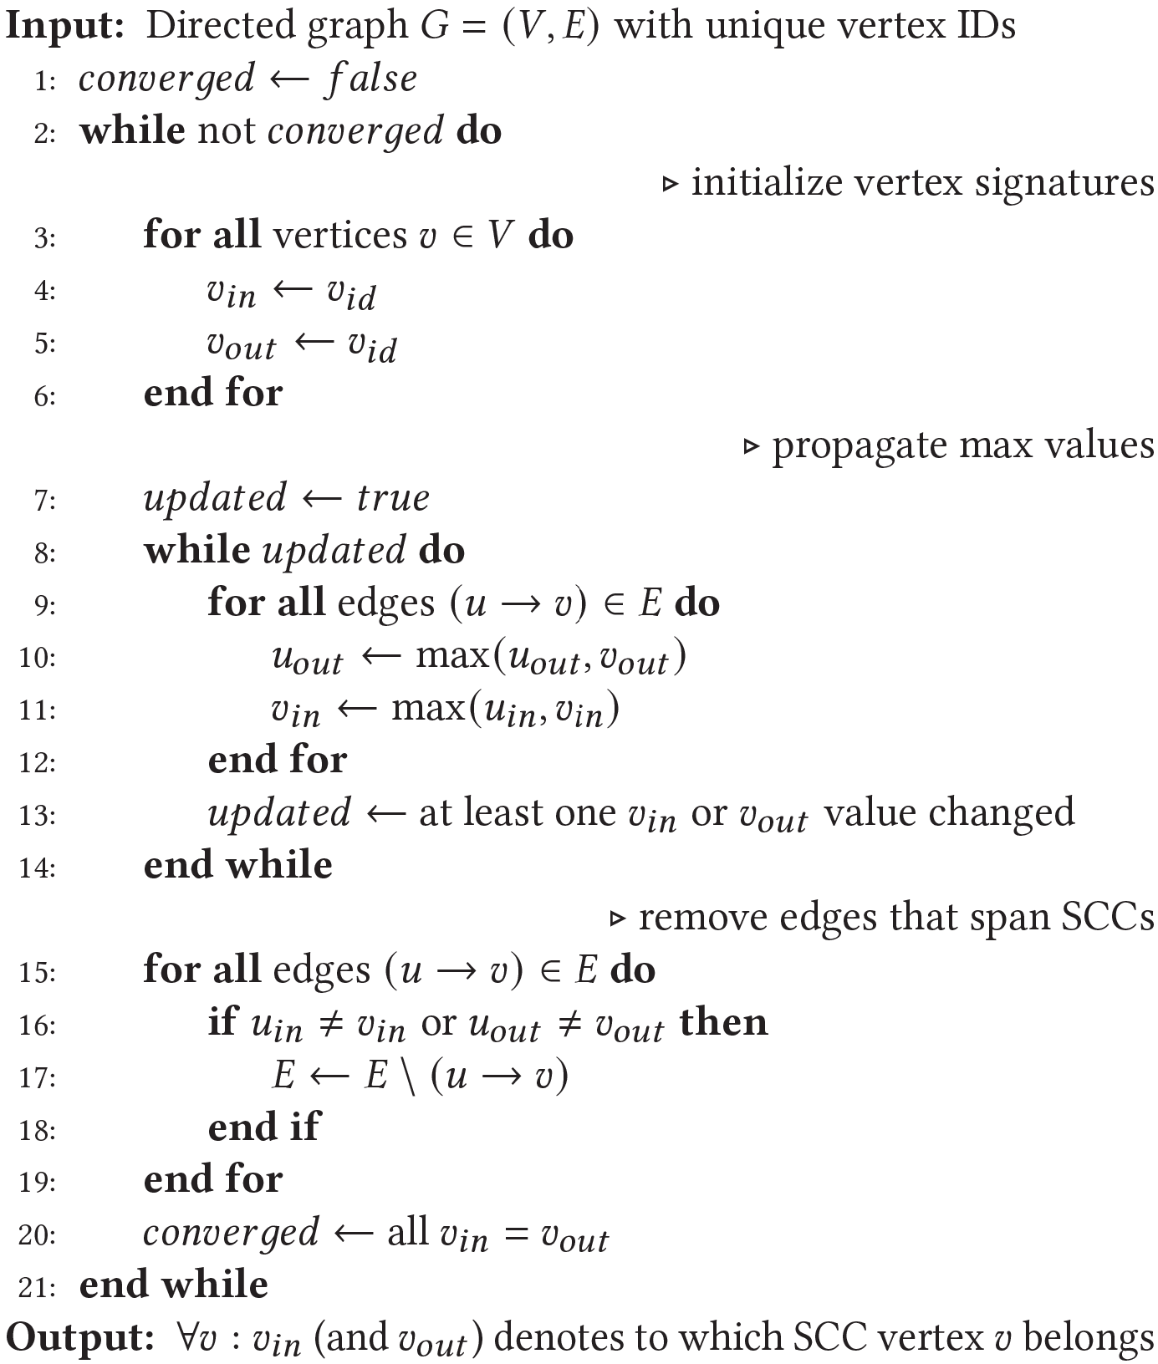
ECL-SCC Algorithm

